Slide 1
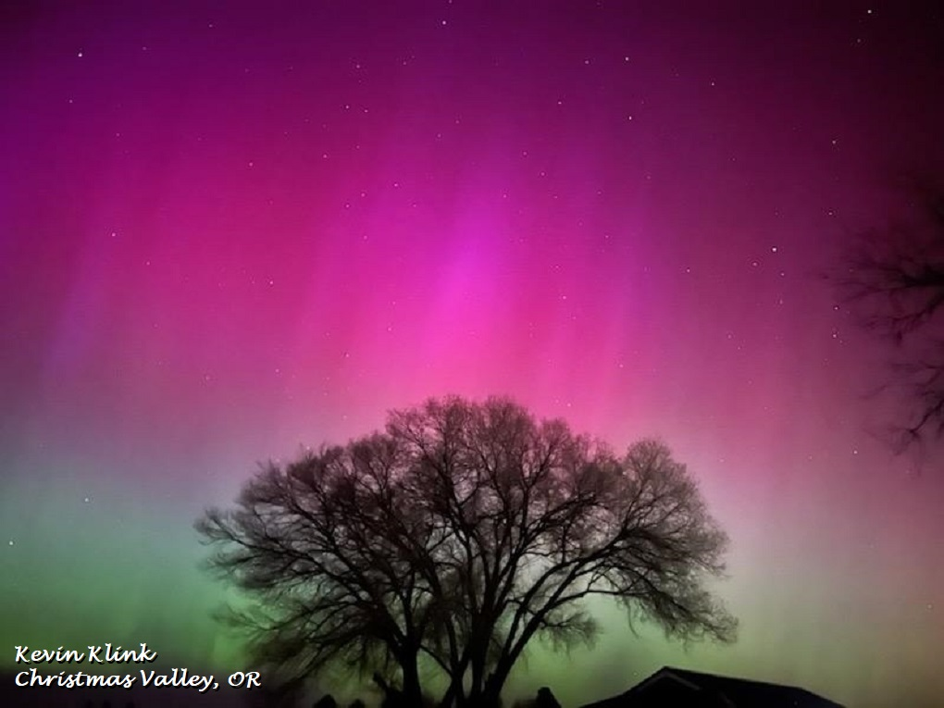
Seasonal Climate Forecast June – August 2024 Issued: May 16, 2024
Contact: ODF Lead Meteorologist Pete Parsons
503-945-7448 or peter.gj.parsons@odf.oregon.gov
ODA Team: Diana Walker; Andy Zimmerman; Jenn Ambrose; Taylor Harding ODF Team: Julie Vondrachek; Kristin Cody

Slide 2
El Niño vs La Niña (SST Patterns in the Tropical Pacific Ocean)
Courtesy: https://www.cpc.ncep.noaa.gov/products/analysis_monitoring/ensocycle/ensocycle.shtml

Slide 3
Sea Surface Temperatures (SSTs) Animated (PowerPoint only) SSTs (top) / Anomalies (bottom)
El Niño is Transitioning to ENSO-Neutral
Courtesy: https://www.cpc.ncep.noaa.gov/products/analysis_monitoring/enso_update/gsstanim.shtml
Notes:
Image available at: https://www.cpc.ncep.noaa.gov/products/analysis_monitoring/enso_update/gsstanim.shtml

Slide 4
El Niño Southern Oscillation (ENSO) Current Status and Forecast
The April Southern Oscillation Index (SOI) of -0.2, reflected near-average trade winds across the tropical Pacific Ocean, corresponding with an ongoing transition to ENSO-neutral conditions.
The February – April Oceanic Niño Index (ONI) fell to +1.1°C, indicating continued cooling of the central and eastern tropical Pacific Ocean sea surface temperatures (SSTs).
*NOAA’s Climate Prediction Center (CPC) expects an imminent transition to ENSO-neutral conditions with La Niña likely developing by the end of summer and continuing through this coming winter.
*This forecast does not consider NOAA’s ENSO forecast. It uses only historical and current ENSO conditions to find “analog years” that most-closely match the recent evolution of the ENSO state.
https://www.cpc.ncep.noaa.gov/products/analysis_monitoring/lanina/enso_evolution-status-fcsts-web.pdf
Notes:
Weekly ENSO update: https://www.cpc.ncep.noaa.gov/products/analysis_monitoring/lanina/enso_evolution-status-fcsts-web.pdf

Slide 5
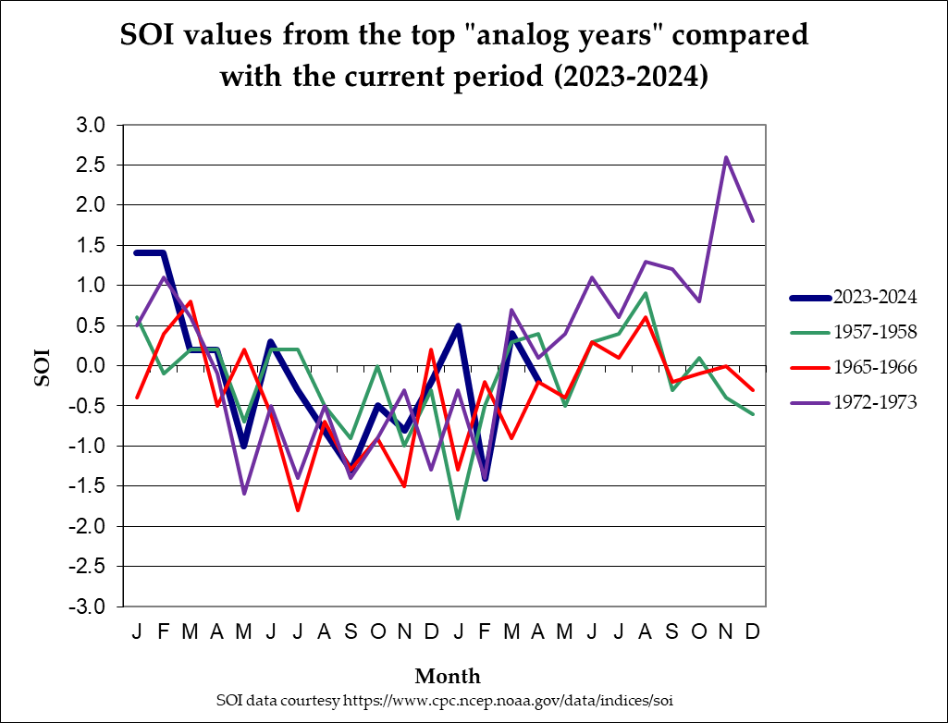
Southern Oscillation Index (SOI)
(1957-1958; 1965-1966; 1972-1973)
April 2024 SOI (-0.2) reflects ENSO-Neutral conditions
La Niña
ENSO-Neutral
April SOI analogs spanned the ENSO-Neutral zone
El Niño
Notes:
SOI data from: https://www.cpc.ncep.noaa.gov/data/indices/soi

Slide 6
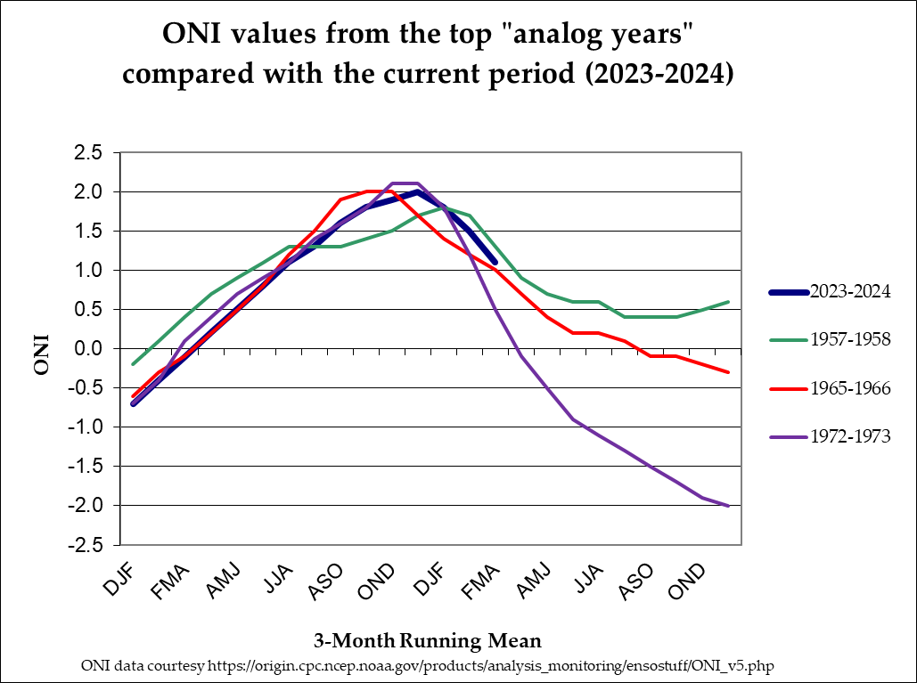
Oceanic Niño Index (ONI)
Feb. – Apr. 2024 ONI (+1.1°C)
reflects a weakening El Niño
(1957-1958; 1965-1966; 1972-1973)
Strong
Moderate
El Niño
Weak
ENSO-Neutral
Weak
Moderate
Strong
La Niña
Feb. – Apr. ONI analogs reflected weakening El Niño events
Notes:
ONI data from: https://origin.cpc.ncep.noaa.gov/products/analysis_monitoring/ensostuff/ONI_v5.php

Slide 7
The Pacific Decadal Oscillation (PDO) (Reflects SST “Phase” in the North Pacific Ocean )
Positive (Warm)
“Phase”
Negative (Cool)
“Phase”
SST Anomalies
Courtesy: http://research.jisao.washington.edu/pdo/img/pdo_warm_cool.jpg

Slide 8
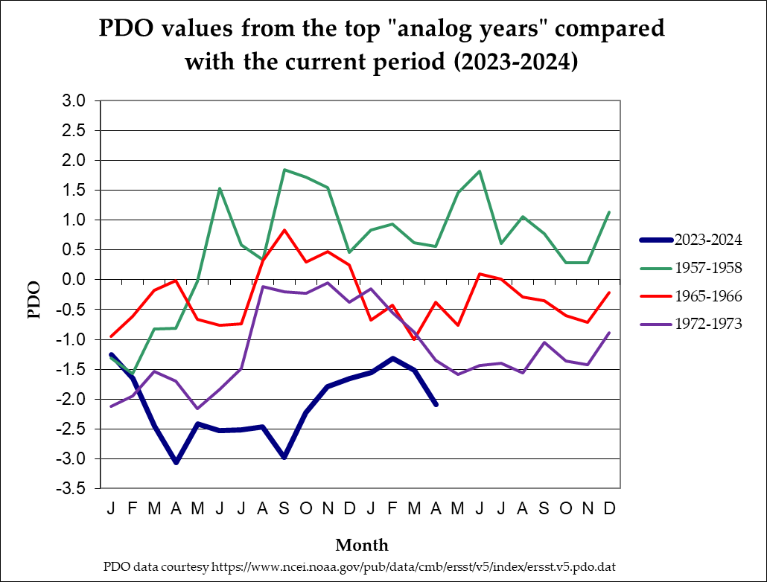
North Pacific Ocean (Poleward of 20°N Latitude)
(1957-1958; 1965-1966; 1972-1973)
April analog PDO values ranged from “Neutral” to “Cool” Phase
Warm Phase
Neutral Phase
April 2024 PDO (-2.09) fell deeper into “Cool” Phase
Cool Phase
Notes:
PDO data from: https://oceanview.pfeg.noaa.gov/erddap/tabledap/cciea_OC_PDO.htmlTable?time,PDO

Slide 9
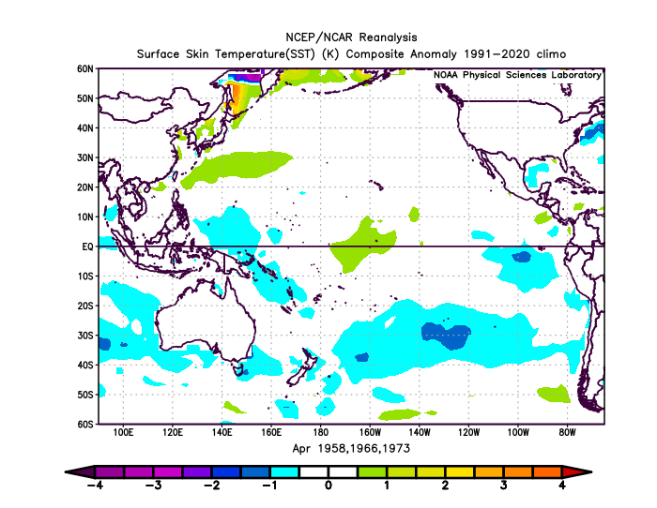
SST Anomalies Comparison
April Analogs
April 2024
The April analogs (left) reflected a faster transition to ENSO-neutral conditions than we are experiencing (right)...but not a bad match.
Both charts show weakening of their respective El Niño events in the tropical Pacific Ocean (a key for analog matching).
Notes:
Charts generated at: https://www.esrl.noaa.gov/psd/cgi-bin/data/composites/printpage.pl

Slide 10
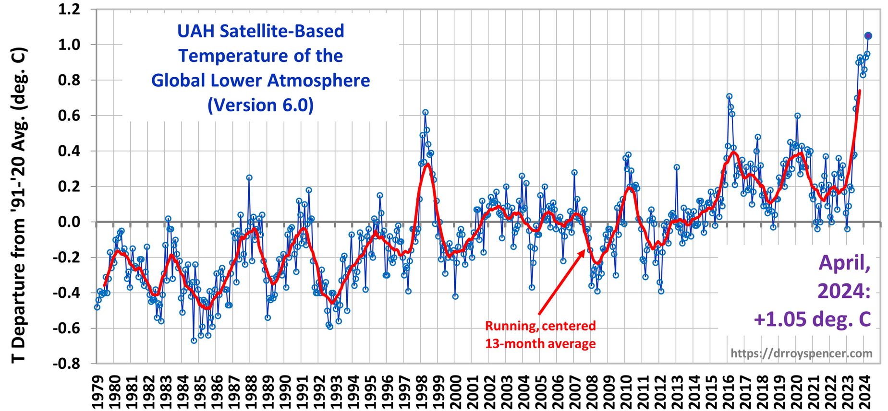
El Niño & La Niña Impact Global Temperatures...
El Niño
La Niña
Courtesy: http://www.drroyspencer.com/latest-global-temperatures/
Notes:
Charts generated at: https://www.esrl.noaa.gov/psd/cgi-bin/data/composites/printpage.pl

Slide 11
Global Temperature Trends Increase Error in Analog Forecasts!
April 2024
Warming of ≈0.15°C / Decade Since 1979
Current Analogs
are Pre-1979
Courtesy: http://www.drroyspencer.com/latest-global-temperatures/
Notes:
Charts generated at: https://www.esrl.noaa.gov/psd/cgi-bin/data/composites/printpage.pl

Slide 12
Notes:
Map created by ODA. Shape file from Oregon Climate Service (George Taylor)

Slide 13
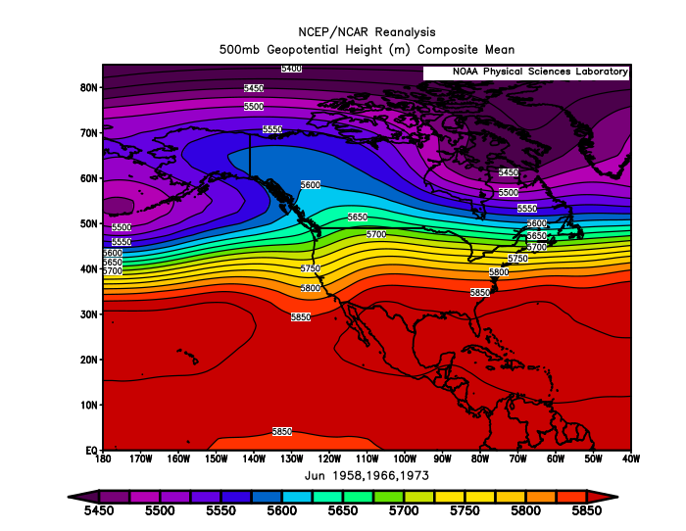
June 2024 Forecast
Mean Upper-Air Pattern
Upper-Air Anomalies
A “split-flow” jet stream pattern should continue across the Pacific Northwest with enhanced storm activity directed towards California.
This is a relatively warm pattern, but prolonged extreme temperatures are not featured. Thundershower activity may be enhanced.
Notes:
Charts generated at: https://www.esrl.noaa.gov/psd/cgi-bin/data/composites/printpage.pl

Slide 14
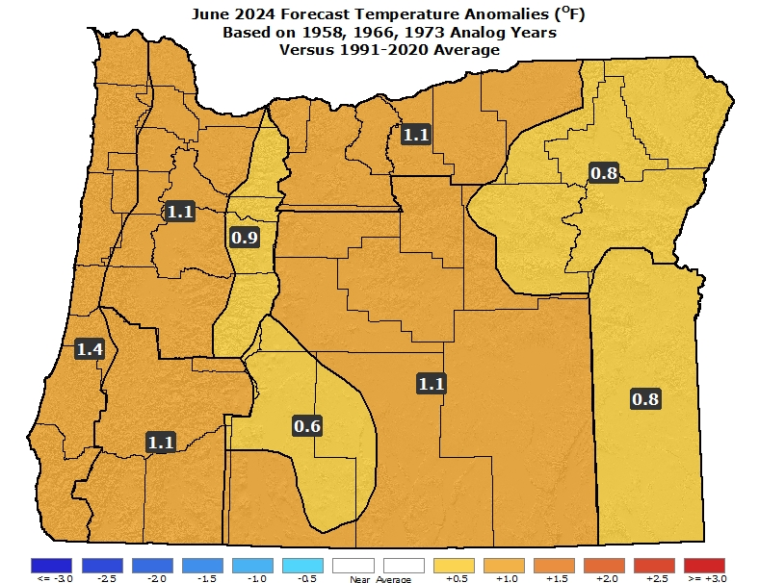
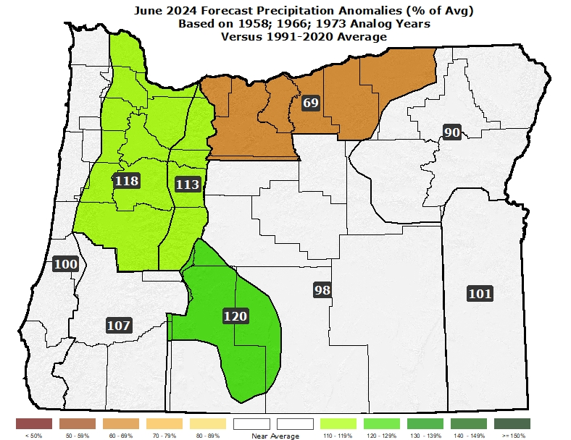
June 2024 Forecast
Temperatures
Precipitation
Above-average temperatures with some “warm” spells (over 90°F in the interior) likely from mid-month on...
Expect ample days with precipitation and a threat of thunderstorms.
Notes:
Data from NCEI: https://www.ncdc.noaa.gov/ & Charts generated locally by ODA

Slide 15
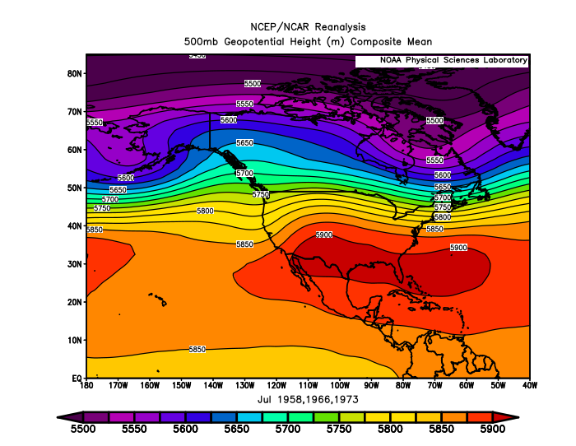
July 2024 Forecast
Mean Upper-Air Pattern
Upper-Air Anomalies
The analog composite shows anomalous ridging centered along the B.C. Coast with some downstream troughing over the Pac NW.
A “split-flow” pattern should persist along the west coast of North America despite a likely transition to ENSO-neutral conditions.
Notes:
Charts generated at: https://www.esrl.noaa.gov/psd/cgi-bin/data/composites/printpage.pl

Slide 16
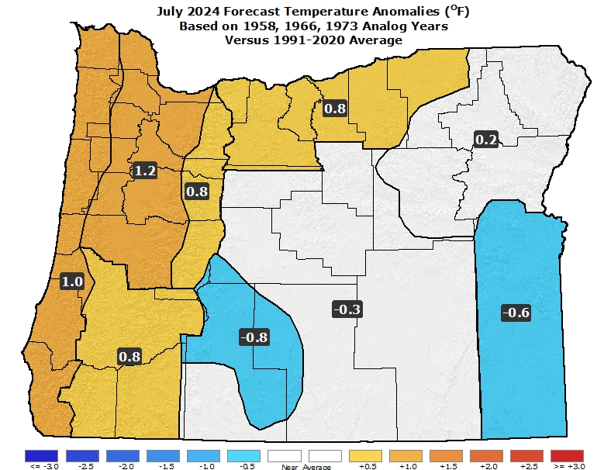
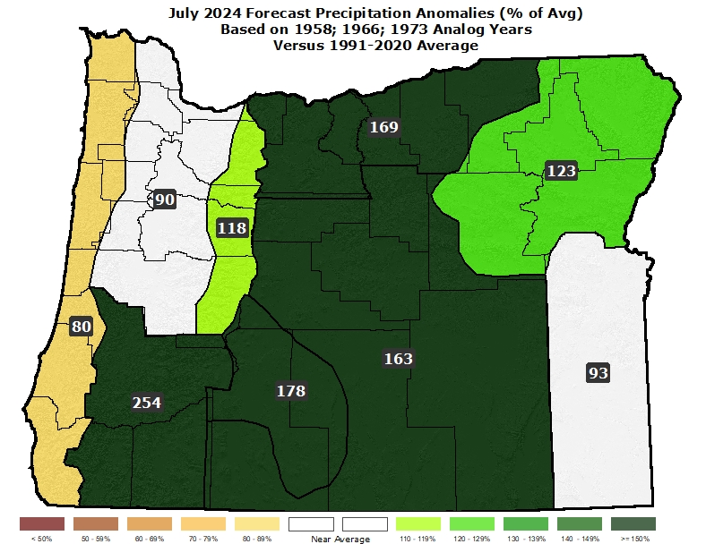
July 2024 Forecast
Temperatures
Precipitation
Analog years straddled either side of average temperatures with 1966 being the coolest and 1958 the warmest.
A wet 1966 skews the precipitation to near or above normal, despite both 1958 & 1973 being drier than average (lowers forecast confidence).
Notes:
Data from NCEI: https://www.ncdc.noaa.gov/ & Charts generated locally by ODA

Slide 17
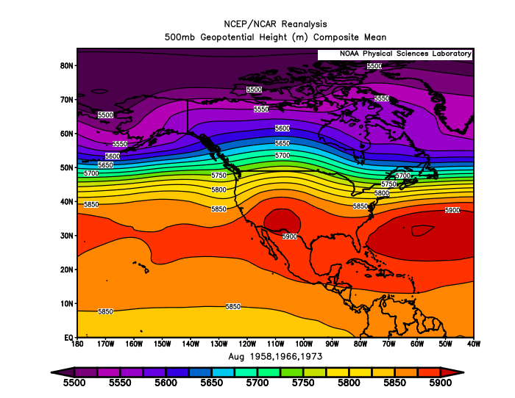
August 2024 Forecast
Mean Upper-Air Pattern
Upper-Air Anomalies
All 3 of the top analogs have a prevailing SW flow aloft over Oregon, with 1958 & 1966 having stronger ridging compared to 1973.
This upper-air pattern favors above-normal temperatures and opens the door for enhanced thunderstorm activity.
Notes:
Charts generated at: https://www.esrl.noaa.gov/psd/cgi-bin/data/composites/printpage.pl

Slide 18
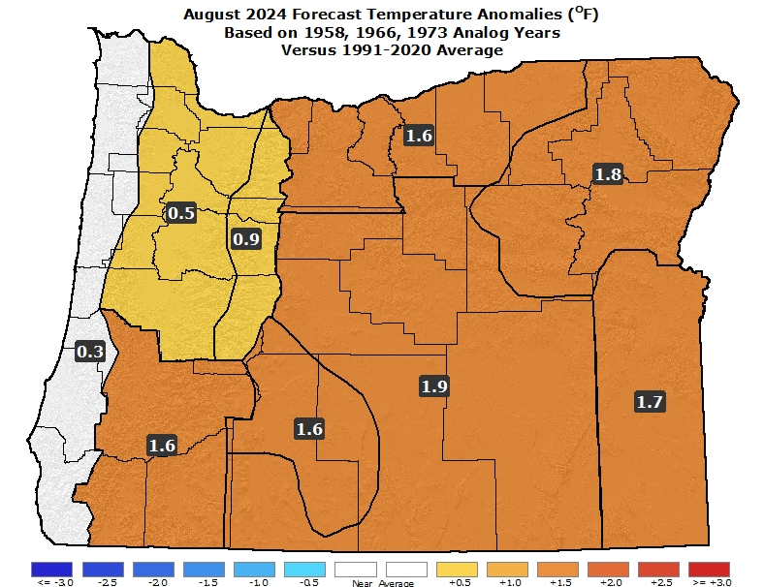
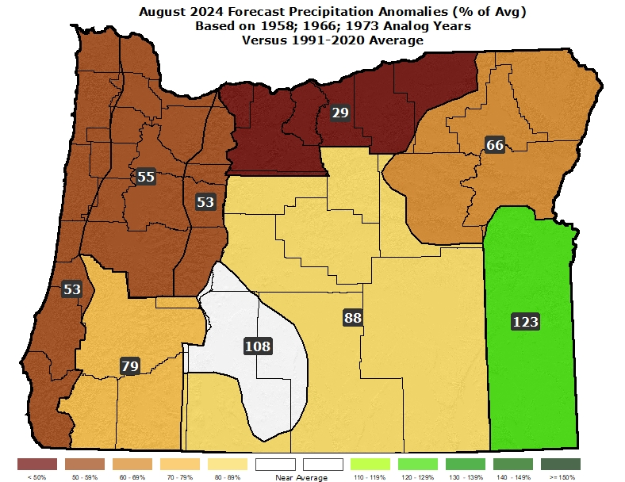
August 2024 Forecast
Temperatures
Precipitation
A very warm 1958 is tempered by progressively cooler 1966 & 1973 analogs. Warmer overall conditions are favored.
Analogs had below-average rainfall, except for spotty downpours with thunderstorms. 1958 & 1966 had considerable thunderstorm activity.
Notes:
Data from NCEI: https://www.ncdc.noaa.gov/ & Charts generated locally by ODA

Slide 19
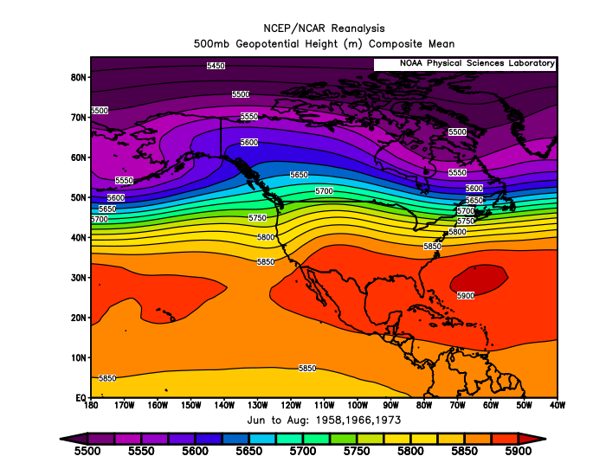
June – August 2024 Forecast
Mean Upper-Air Pattern
Upper-Air Anomalies
Expect a gradual weakening of the “split-flow” pattern that El Niño was largely responsible for establishing along the west coast.
Prevailing SW flow aloft favors warmer and drier than average summertime weather but can also promote thunderstorm activity.
Notes:
Charts generated at: https://www.esrl.noaa.gov/psd/cgi-bin/data/composites/printpage.pl

Slide 20
June – August 2024 Forecast
Temperatures
Precipitation
Above-average temperatures, but long heat waves and/or periods of extreme heat are not indicated.
Near-average rainfall. Increased chances for thunderstorms, especially south and east, which can cause local excessive rainfall.
Notes:
Data from NCEI: https://www.ncdc.noaa.gov/ & Charts generated locally by ODA

Slide 21
Forecast Highlights
This forecast is based on weather that occurred during the (1958; 1966; 1973) analog years (no changes to the analogs from last month).
With El Niño ending, the prevailing “split-flow” jet stream pattern along the west coast of North America should slowly weaken.
Relatively “warm & dry” weather is favored, but prevailing SW flow aloft may enhance thunderstorm development, which increases the chances for wildfire starts and/or local bursts of heavy rain/hail.
Of the three top analog years, 1958 had the most thunderstorm activity, with progressively fewer storms in 1966 and 1973.
Disclaimer: This forecast is not associated with NOAA’s CPC (see “Forecasting Methods…” at: https://oda.direct/Weather) nor the official CPC “Three-Month Outlooks,” which are available at:
https://www.cpc.ncep.noaa.gov/products/predictions/long_range/seasonal.php?lead=1

Slide 22
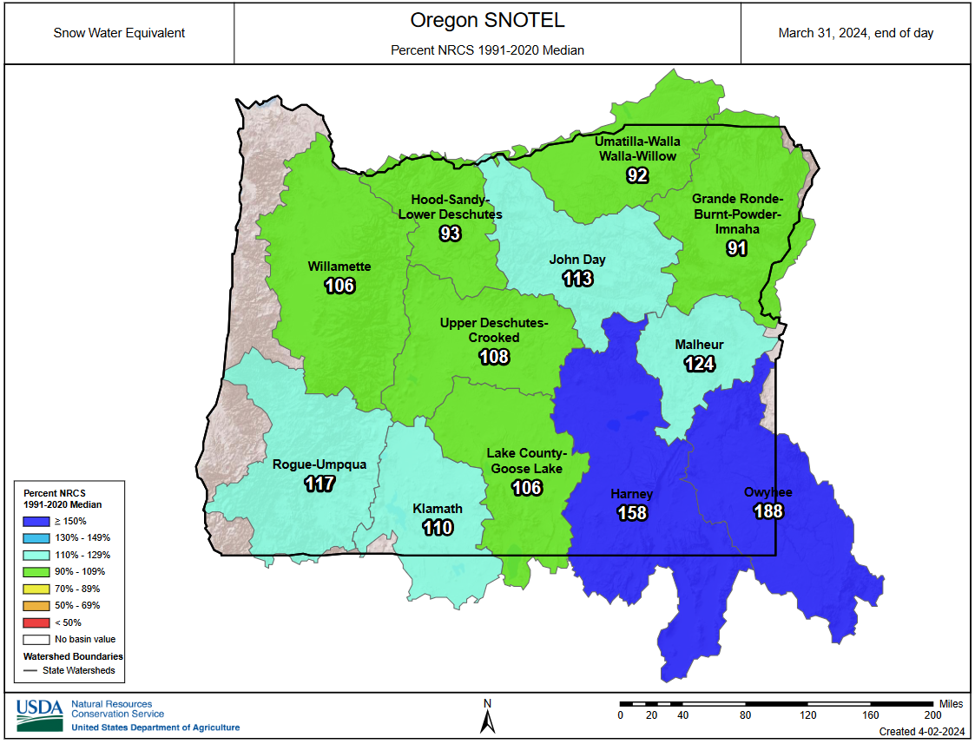
Peak Spring Snowpacks Near-to-Above Average
(end of March 2024)

Slide 23
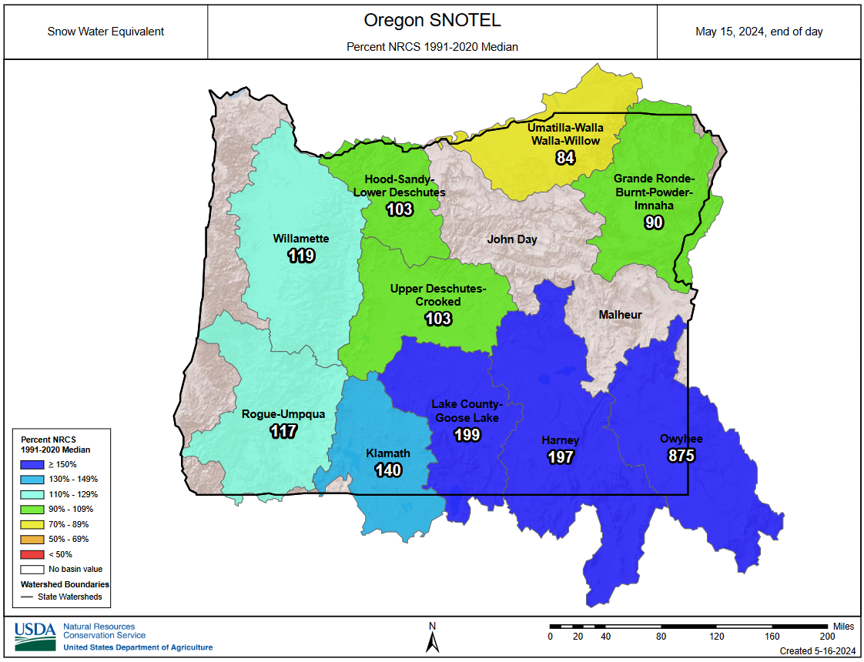
Current Snowpacks
(Mid-May 2024)

Slide 24
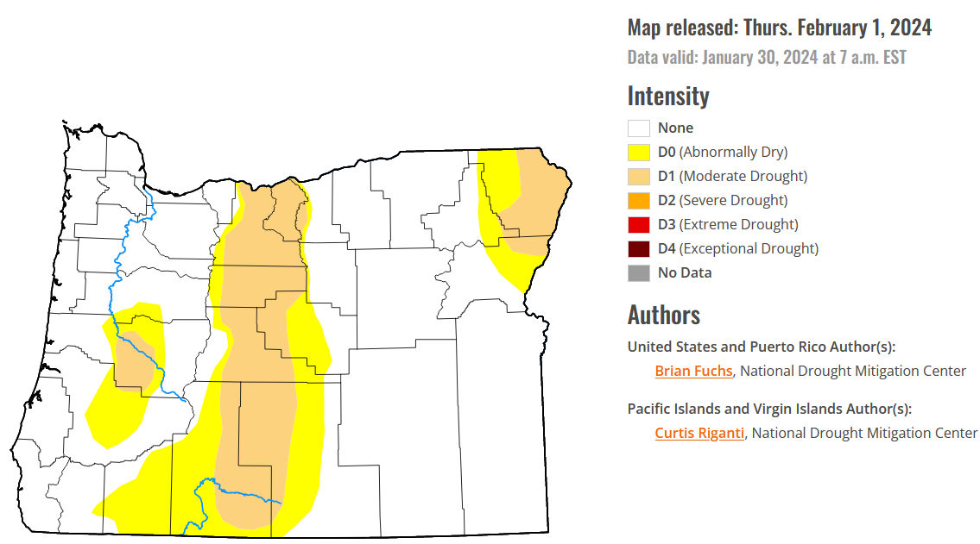
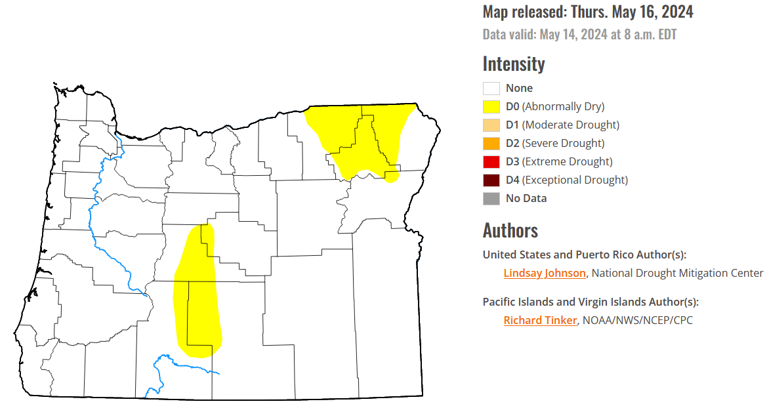
Continued Drought Improvement
(over the past 3 months)
February 1, 2024
May 14, 2024
Courtesy: National Drought Mitigation Center (NDMC)
https://droughtmonitor.unl.edu/

Slide 25
Forecast Resources
ODA Seasonal Climate Forecast Home:
https://www.oregon.gov/ODA/programs/NaturalResources/Pages/Weather.aspx
CPC Official US Three-Month Forecasts (Graphics):
https://www.cpc.ncep.noaa.gov/products/predictions/long_range/seasonal.php?lead=01
CPC US 30-Day & 90-Day Forecasts (Discussions):
https://www.cpc.ncep.noaa.gov/products/predictions/long_range/fxus07.html
CPC Weekly & Monthly ENSO Discussions: https://www.cpc.ncep.noaa.gov/products/analysis_monitoring/enso_advisory
Australian Government Climate Model Summary:
http://www.bom.gov.au/climate/model-summary/#region=NINO34&tabs=Overview
Australian Government ENSO Wrap-Up:
http://www.bom.gov.au/climate/enso
IRI ENSO Quick Look:
https://iri.columbia.edu/our-expertise/climate/forecasts/enso/current/

Slide 26
Water Supply / Fire-Potential Outlook
CPC U.S. Seasonal Drought Outlook:
https://www.cpc.ncep.noaa.gov/products/expert_assessment/season_drought.png
NRCS Snow Water Equivalent Oregon Map:
https://www.wcc.nrcs.usda.gov/ftpref/data/water/wcs/gis/maps/or_swepctnormal_update.pdf
NRCS/USDA Snow Water Equivalent Products:
https://www.nrcs.usda.gov/wps/portal/wcc/home/snowClimateMonitoring/snowpack/
NDMC U.S. Drought Monitor:
https://droughtmonitor.unl.edu/
NIDIS North American Drought Portal:
https://www.drought.gov/nadm/content/percent-average-precipitation
WRCC WestWideDroughtTracker:
https://www.wrcc.dri.edu/wwdt/
NWCC Northwest Interagency Coordination Center (video)
https://gacc.nifc.gov/nwcc/predict/outlook.aspx

Slide 27
Updated Monthly
Your Feedback is Welcome!
Sign-up for Email Notification of Updates at:
https://oda.fyi/SubscribeSCF
Contact: Pete Parsons, ODF Lead Meteorologist
at 503-945-7448 or peter.gj.parsons@odf.oregon.gov

