Slide 1
Title I-D, Subpart 2: Basics
Neglected, Delinquent & At-Risk Youth

Slide 2
Oregon Department of Education – Our “Why”
Equity and Excellence for Every Learner
The Oregon Department of Education works in partnership with school districts, education service districts and community partners;
Together, we serve over 580,000 K-12 students;
We believe every student should have access to a high-quality, well-rounded learning experience;
We work to achieve the Governor’s vision that every Oregon student graduates with a plan for their future.

Slide 3
Outcomes for Today
Overview of Title I, Part D basics including:
Eligibility and Funding
Application requirements
Allowable use of funds
Resources
Notes:
Today I will be sharing with you an overview of the basic components and requirements of Title V-A including funding & eligibility and the different programs that fall under REAP.
We’ll also discuss requirements for submitting the Title VA application and allowable uses.

Slide 4
Purpose of Title I-D, Subpart 2
The purpose of Title I-D, Subpart 2 is to improve educational services for students in locally operated facilities for neglected or delinquent students to:
Provide opportunity to meet state standards
Improve transitions into community
Prevent drop out and return to facilities
Notes:
The purpose of Title I-D is to improve educational services for students in local, tribal, and state facilities or institutions for neglected (N), delinquent (D), or at-risk youth. These students have increased rates of absenteeism, dropping out, and not meeting state academic standards.
Title I-D provides federal funding to state agencies and districts that provide educational services to this population with the following intentions:
Improve educational services for neglected, delinquent, or at risk students, so they have the opportunity to meet state academic standards.
Improve student transition between correctional facilities or institutions and community programs in education, technical training, or employment.
Prevent at-risk students from dropping out of school or returning to correctional facilities. This includes providing support systems to ensure continued education for these students.

Slide 5
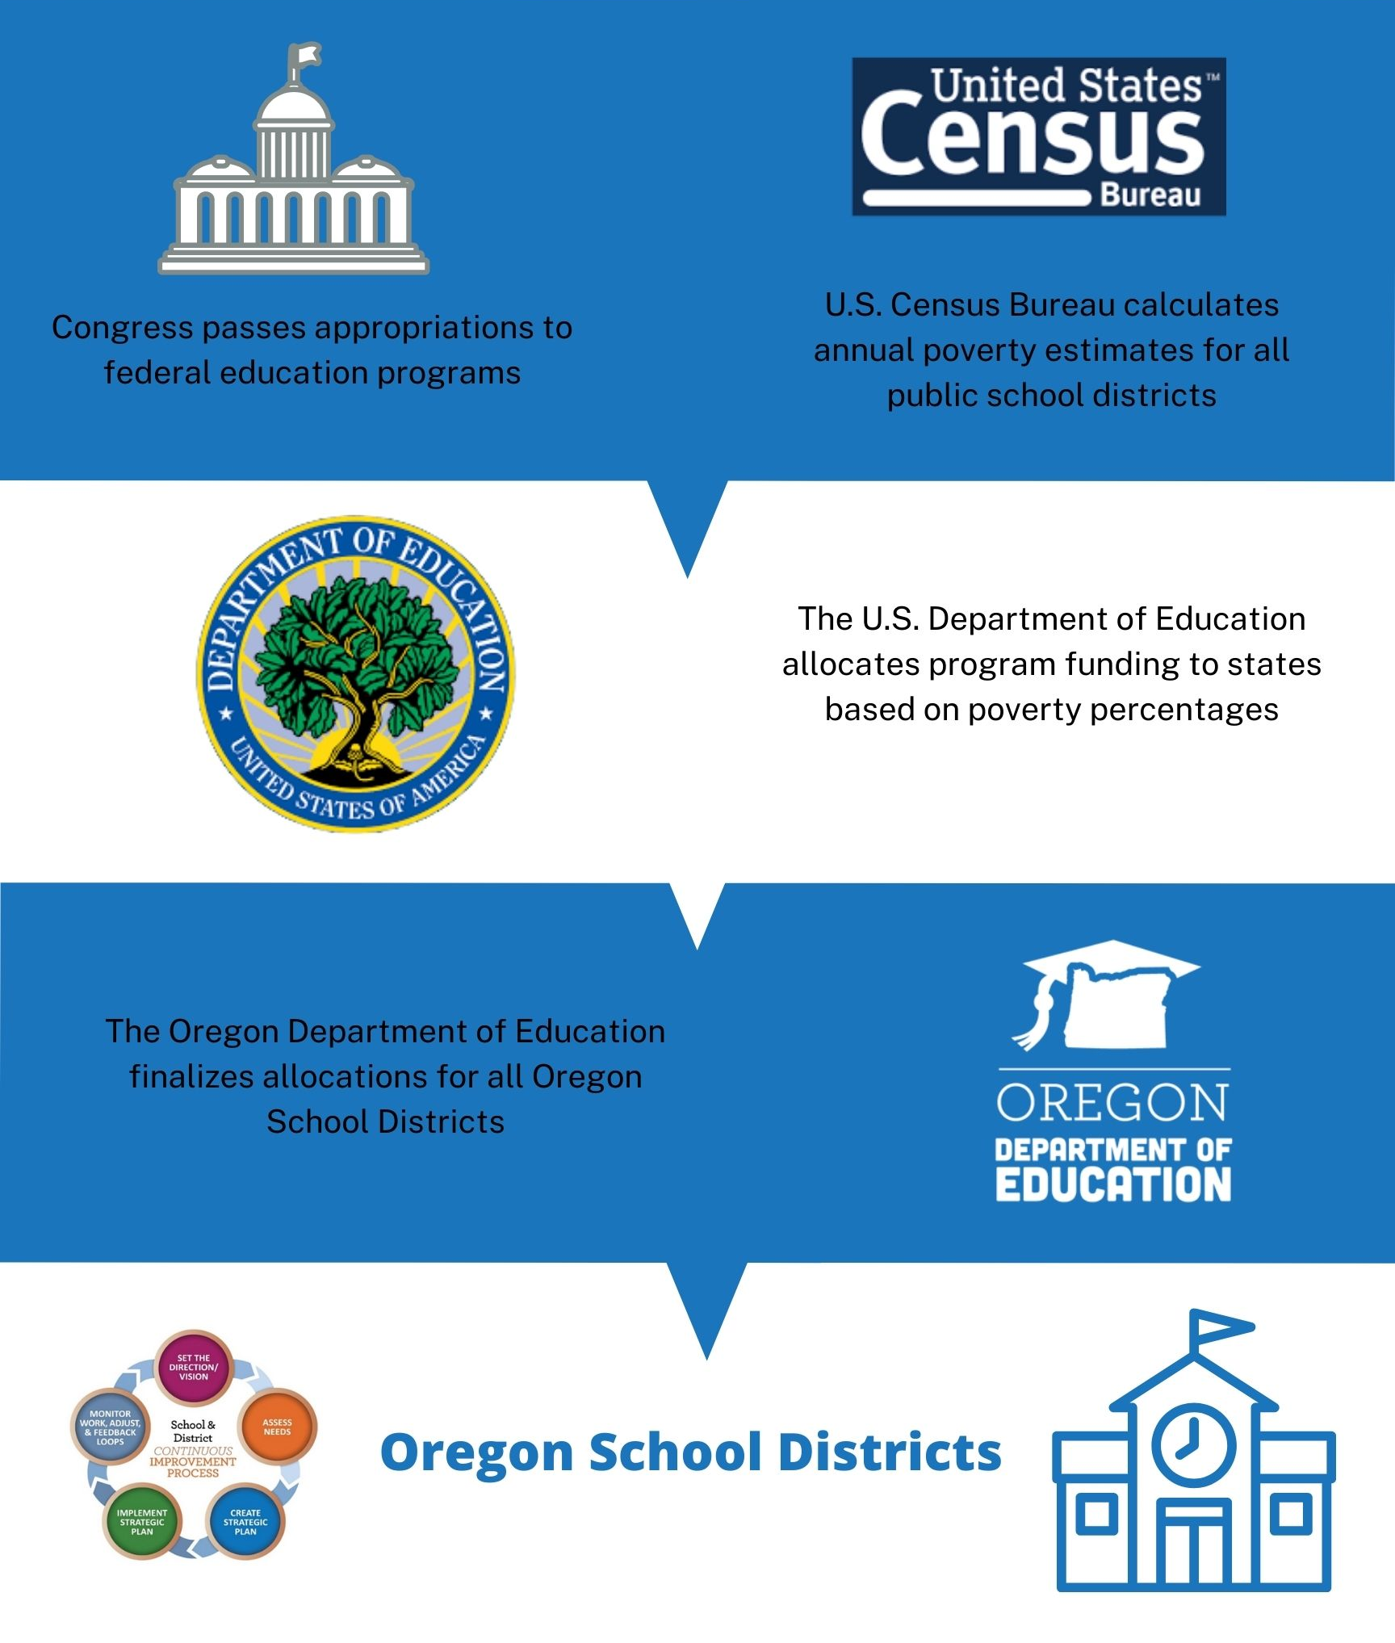
Eligibility and Funding
Eligibility:
An LEA is eligible to receive funds if there is a locally operated facility within its geographical boundaries
Funding:
Determined by annual October Caseload Count
Neglected funds flow through Title I-A
Funds can be used at facility, district, and school levels
Notes:
For a district to be eligible for a Title I-D Subpart 2 grant, there must be a qualifying locally operated facility for neglected or delinquent youth within district geographical boundaries.
Locally Operated facilities are those run by county or city agencies or that are privately ran. This does NOT include state run agencies. For example, facilities ran by the Oregon Youth Authority or (YCEP) programs are not considered a locally run facility . McClaren, the YCEP facility may be in Woodburn school district boundaries, but the school district does not qualify for a Title I-D Subpart 2 grant because it is a state-run facility.
A Juvenile Detention or (JDEP) facility, such as Marion County JDEP is ran by the county, and therefore the local school district is eligible to receive funds. In other to receive funding, that district submits an October Caseload Count, which generates funds for the following school year.
It should be noted that districts that report a neglected facility, receive funds through Title I-A. No matter how the funds are generated, there are a variety of allowable uses.

Slide 6
Transferability
Funds can be transferred into Title I-D
Can transfer all or a portion of the funds into a grant award for the same year
Must be claimed from original award in EGMS
Carryover funds cannot be transferred
ESSA Quick Reference Brief: Transferability
Notes:
Under ESEA districts have the ability to transfer funds it receives by formula under certain programs to other programs to better address local needs. It is important to keep in mind that once funds are transferred, they take on the identity of the Title to which they were transferred and must be spent under rules applicable to that Title.
There is no limit on the amount of funds that can be transferred from one grant to another, but transfers of funds cannot cross years.​
​
A district cannot transfer funds into a program it does not receive an allocation for, or a program for which it declined an allocation.​
​
Carryover funds cannot be transferred between title programs. Once it becomes carryover, transferability is no longer an option. (NOTE FOR US: This means that if you didn’t transfer it in the initial year, you can’t transfer the remainder once it becomes carryover. If a district did not spend all its transferred funds from the first year it can still use them as transferred funds in the carryover year.
It is important to note that carryover funds cannot be transferred between title programs. Once the initial grant period is over (first 15 months) transferability is no longer an option.

Slide 7
Allowable Uses of Title I-D, Subpart 2
Requirements
Prepare students to complete high school, enter training or employment programs, or further education
Facilitate transition
Dropout prevention programs
Suggestions
Serve “at-risk” youth
Coordinate health and social services
Mentoring & peer mediation
CTE, special education, career counseling
Notes:
Title ID funds can be used to:
Carry out high-quality education programs that prepare children and youth to complete high school, enter training or employment programs, or further their education;
Provide activities that facilitate the transition from the correctional program in an institution to further education or employment; and
Operate dropout prevention programs in local schools for children and youth who are at-risk of dropping out or youth returning from correctional facilities.

Slide 8
2022-23 FEDERAL FUNDS TIMELINE
JULY
2022
AUG 2022
NOV 2022
BEGINNING OF 2022-23 GRANT PERIOD
2022-23 BUDGET NARRATIVE APPLICATION OPENS
2022-23 BUDGET NARRATIVES DUE
NOV 2023
SEPT 2023
FINAL DATE FOR ALL 2022-23 CLAIMS FOR *INITIAL GRANT PERIOD
FINAL DATE FOR OBLIGATION OF 2022-23 FUNDS FOR *INTIAL GRANT PERIOD
NOV 2023
UNCLAIMED FUNDS BECOME “CARRYOVER”
NOV 2023
SEPT 2024
NOV 2024
CARRYOVER APPLICATIONS FOR 2022-23 FUNDS OPEN
FINAL DATE FOR OBLIGATION OF 2022-23 FUNDS
FINAL DATE FOR ALL 2022-23 GRANT CLAIMS
*INITIAL GRANT PERIOD: 7/1/22 – 9/30/23 (15 MONTHS)
Notes:
Title I-D funds are made available on July 1 of the fiscal year and remain available for obligation for a period of 27 months. This 27-month period includes an initial 15-month period of availability and an automatic 12-month extension permitted under the “Tydings Amendment”. While districts are encouraged to obligate funds in the initial grant year, it is not uncommon for districts to have funds available from two different grant years.
This slide shows the 2022-23 grant year timeline.

Slide 9
Supplement Not Supplant
Title I-D cannot be used to supplant, or take the place of, state or local funds that would have been spent if federal funds were not available
Test I: Are the services that the district wants to fund with ESEA funds required under state, local, or another federal law? If they are, there could be the presumption of supplanting.
Test II: Were state or local funds used in the last year to pay for these services? If they were, there could be a presumption of supplanting.
ESSA Quick Reference Brief: Supplement Not Supplant
Notes:
There is a federal provision of supplement, not supplant in Title I, Part D: Funds received under this subpart shall be used to supplement, and not supplant, non-Federal funds that would otherwise be used for activities authorized under this subpart.
To determine whether a fiscal expenditure supplements and does not supplant, school districts must run the following tests:
Test I: Are the services that the district wants to fund with ESEA funds required under state, local, or another federal law? If they are, then it is supplanting.
Test II: Were state or local funds used in the past to pay for these services? If they were, it is supplanting.
It is possible for districts to overcome the presumption of supplanting. Overcoming the presumption of supplanting requires that districts keep documentation (e.g., budget information, planning documents, or other materials). In general, an SEA or LEA must determine what educational activities it would support if no ESEA funds were available. If it is clear that no State or local funds remain available to fund certain activities that previously were funded with State or local resources, then the SEA or LEA may be able to use ESEA funds for those activities.

Slide 10
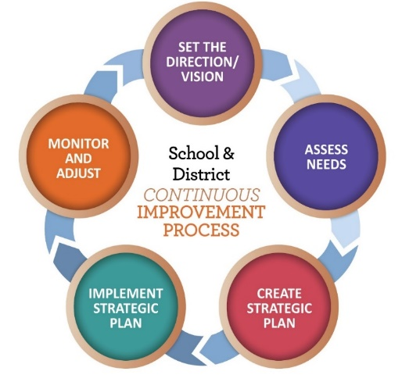
Application Requirements
Completed in CIP Budget Narrative
Answer all questions
Describe and budget for any costs associated with the program
Notes:
There are no large changes to the Title I-D application and budget narrative process this year.
A few years ago, we did change the process to include a handful of questions that came from the Title I-D application process. These questions are required by ESSA, and ask for descriptions of how the district will address a variety of requirements such as special education, coordinating with other federal programs, transition, etc. These questions must be answered, even if there is no cost associated with them.
Districts should provide budget line items for any costs associated with the program and describe how they will be used.
10

Slide 11
Resources
Oregon Department of Education Title I-D
Oregon Department of Education Youth Corrections Juvenile Detention Education Programs
Oregon Department of Education Long Term Care and Treatment Education Programs
USED: Title I-D: Neglected , Delinquent, and At-Risk Youth Non-regulatory Guidance
National Technical Assistance Center for the Education of Neglected or Delinquent Children and Youth (NDTAC)
National Center for Juvenile Justice

Slide 12
Please reach out!
Jen Engberg jennifer.engberg@ode.oregon.gov

Slide 13
Questions?

