Slide 1
Data Profiles
Supplement to the Annual English Learners (EL) Report
October 9, 2023
12:00 Noon – 1:00 PM
Notes:
Mariana

Slide 2
Annual English Learners Report
Produced by ODE per ORS 327.016 and made available by June 30th of each year.
The report in each year reflects on the EL data from the prior year (ex. 2023 EL report uses the 2021-22 data).
Reports on:
The demographics of students in English language learner programs across the state.
The objectives and needs of students eligible for and enrolled in an English language learner program.
Financial information for EL programs.
Notes:
Reza

Slide 3
Limitations of the EL Report
The report focuses on the statewide trends.
District-level information is not included (ex. for cross-district comparison).
Up to 2020, ODE provided a spreadsheet called the “comparison tool”.
Districts could compare their information with up to 2-3 other “similar” districts (ex. similar in EL size).
There was no standardized rating of districts’ performances to allow direct cross-districts comparisons.
Notes:
Reza

Slide 4
Annual Progress Monitoring
State Indicators:
HB 3499 data profiles:
Profiles are available to districts in the fall.
Fall 2021 contained only a few indicators (e.g., graduation, post-secondary enrollment)
Fall 2022 should contained all indicators except growth
Fall 2023 should contain all indicators
Local Metrics:
Districts identify local metrics:
Measurable at multiple time points (if possible)
Reflect improvement efforts and interventions
Association with state indicators
Notes:
Josh

Slide 5
EL Outcomes Program Data Profile
Purpose:
Annual snapshot of district performance
Allows districts to monitor progress by comparing performance to baseline
Consists of five pages:
Page 1: District enrollment and demographics
Page 2: Summary of ratings and determination
Page 3: Summary of indicator performance
Page 4: Thresholds for elementary grades indicators
Page 5: Thresholds for secondary grades indicators
Notes:
Josh

Slide 6
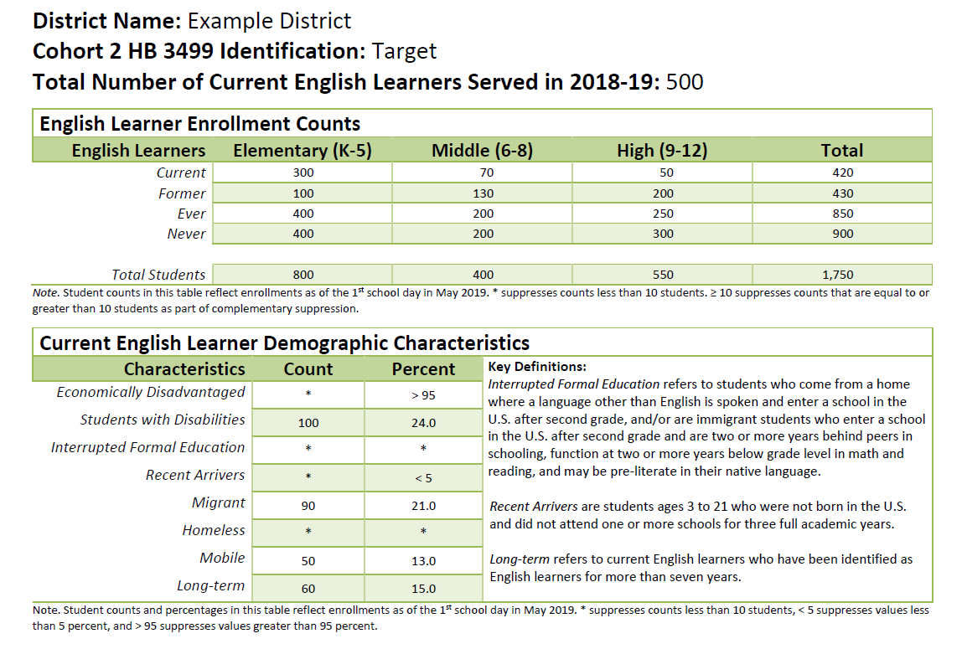
District Enrollment and Demographics

Slide 7
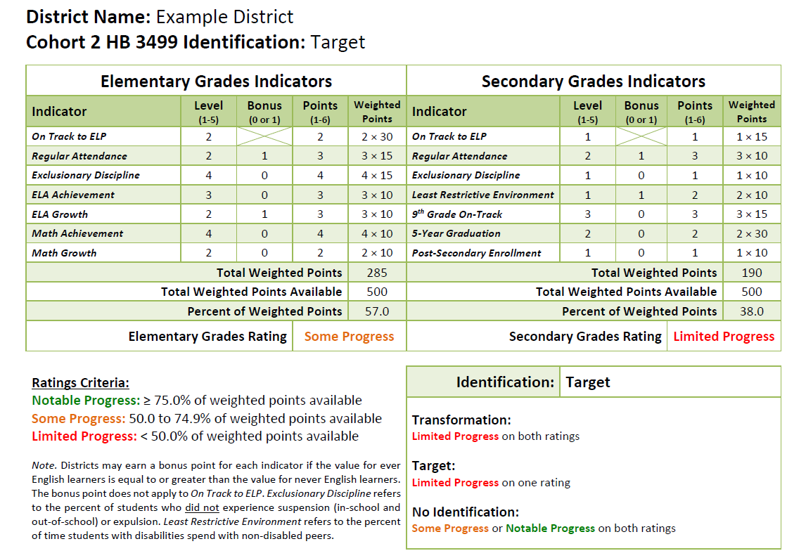
Summary of Ratings and Determination
Notes:
Josh

Slide 8
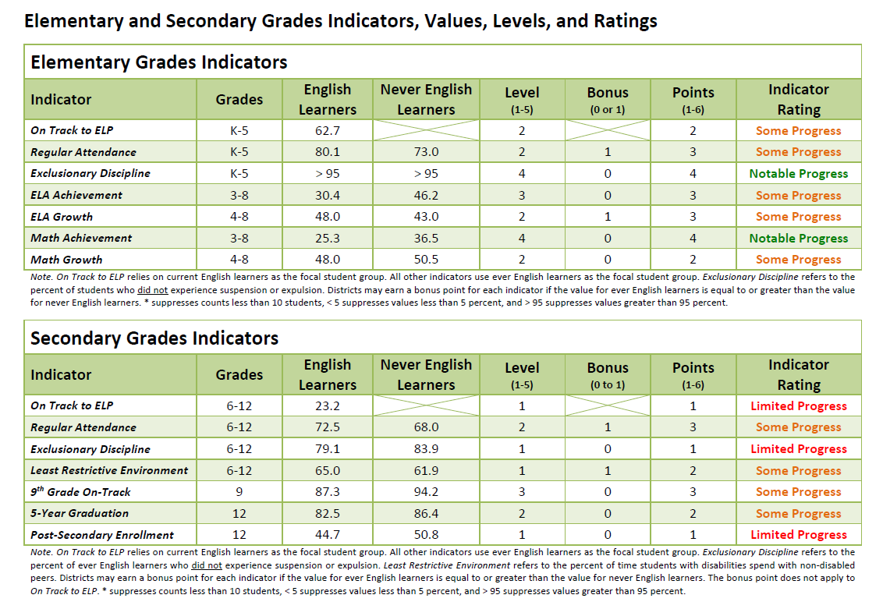
Summary of Indicator Performance
Notes:
Josh

Slide 9
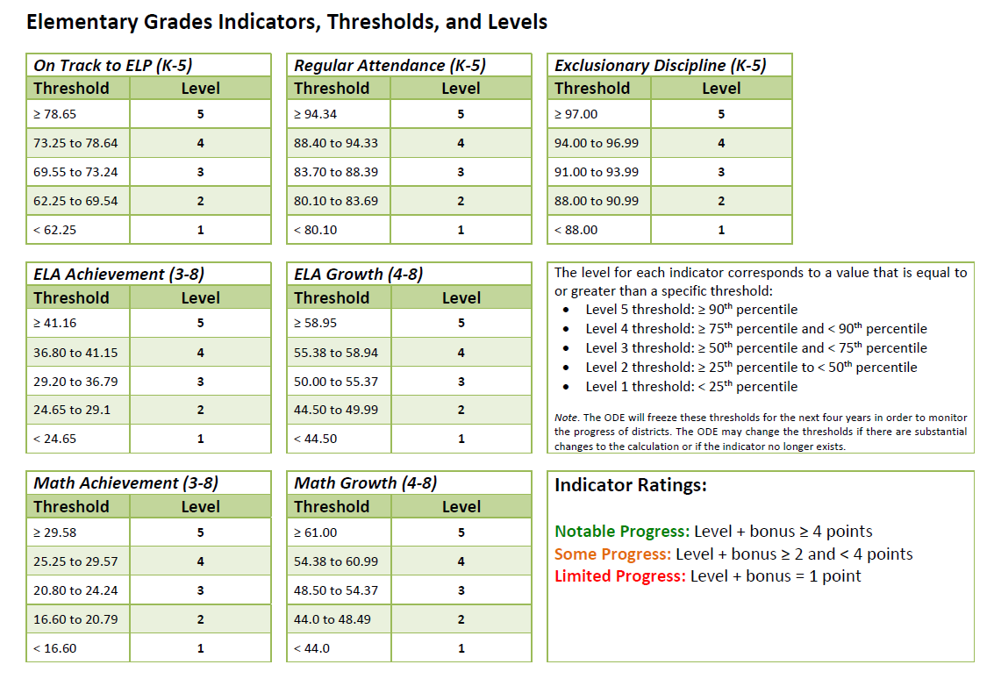
Thresholds for Elementary Grades Indicators
Notes:
Josh

Slide 10
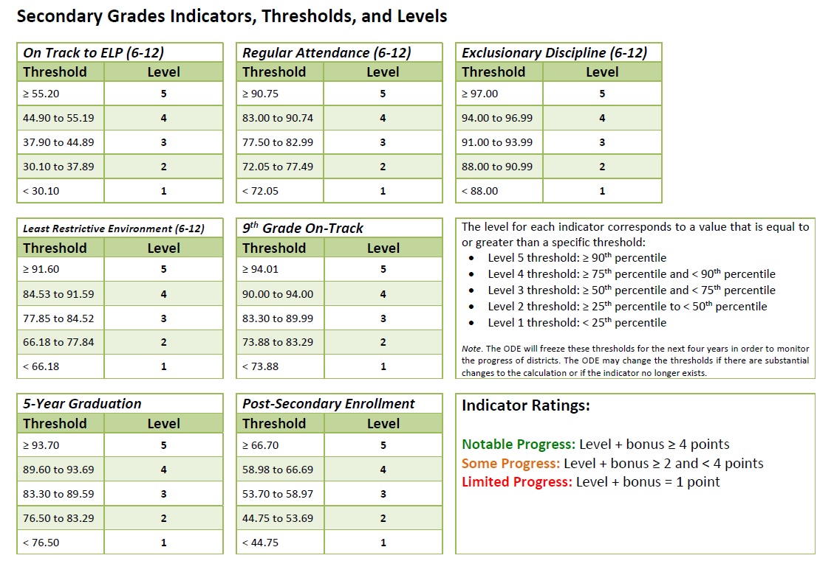
Thresholds for Secondary Grades Indicators
Notes:
Josh

Slide 11
Discussion
Data Profiles: How Can Your District Use These?
Get this image on: iStock | License details
Notes:
Mirela and Susy

Slide 12
Data Profiles: Using the Spreadsheet
The Spreadsheet
Get this image on: iStock | License details
Notes:
Reza

Slide 13
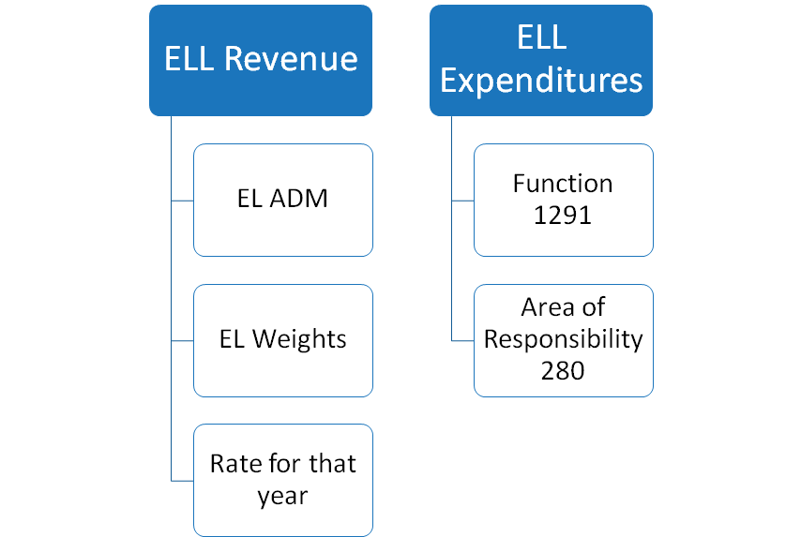
% of EL Revenue Coded to EL Expenditures
Notes:
Evan

Slide 14
Questions?
Get this image on: iStock | License details

Slide 15
Gratitude
Thank you for listening!

