Slide 1
Connecting to ODE Wi-Fi
Select “ODE-Guest” from list of networks.
Mobile devices will ask you to sign in.
Laptops – open a web browser and navigate to www.oregon.gov and follow instructions

Slide 3
Introductions & Overview

Slide 4
Overview
Expectations
More districts may be flagged.
Notes:
I want to set some expectations for today.
We need your participation. Please be present and if at all possible, leave your phones on silent or vibrate.
The new regulations are coming soon and while we have some, SOME, flexibility within them, we do not have much.
Due to the changes and certain requirements in the new regulations, the number of districts flagged may go up.
Depending on the method we choose, the number can range from 2 to 98 in the first year.

Slide 5
Overview
Ranges
Notes:
Ranges are based on data that look at the difference between translating our current methods to the new regulations and using all new methods based on the new regulations.

Slide 6
Overview
SpEd Population:
< 500 = Small
500-1000 = Medium
> 1000 = Large
Notes:
I will also be talking about district sizes often. Here is what I mean. Of the 197 districts monitored for Significant Disproportionality, 160 or 81% of them, have a SpEd population less than 500 students.

Slide 7
Overview
Four Questions
Description
Question Asked
Group Discussion
Repeat
Notes:
We will be asking you to answer four questions today.
I’ll be giving a description of the question that needs answering.
Once the description section is finished, we will be breaking out into groups (either stay at your table or join others) for 15 minutes to discuss and ask more questions.
At the end of the day, we will poll your answers using Poll Everywhere to get instant feedback from everyone at once.

Slide 8
Questions to Answer
Cell/N-size
How many years of data?
Standards for reasonable progress
Threshold Method and Target
Notes:
Should we set minimum Cell and N-sizes that are different than the presumptive maximums (10 and 30)?
How many years of data should be used to identify districts?
What standards for reasonable progress should be used to prevent identification?
Finally, how should we determine the threshold to be used and what should that threshold be?

Slide 9
Questions?
Notes:
Any questions at this point?

Slide 10
Define Minimums

Slide 11
What are Cell size and N-size?
Cell size: Risk Numerator, Minimum Count
N-size: Risk Denominator, Minimum Population
Notes:
Cell Size:
First method used to prevent inappropriate identification.
Minimum number in category for inclusion in analyses.
N-Size:
Second method used to prevent inappropriate identification.
Minimum population to include.

Slide 12
What are Cell size and N-size?
Cell Size
N-size
Notes:
Cell Size: All the people in a group with beards vs.
N-Size: All the people in a group.

Slide 13
What are Cell size and N-size?
Notes:
Cell size and N-size are the barrier for entry.
Helps to limit the impact of one or two families moving in or out of a district.

Slide 14
How does it impact Districts?
SpEd Population:
< 500 = Small
500-1000 = Medium
> 1000 = Large
Notes:
Of the 197 districts monitored for Significant Disproportionality, 160 or 81% of them, have a SpEd population less than 500 students.

Slide 15
How does it impact Districts?
On Average:
123 Small Districts Excluded
Notes:
Of the 197 districts monitored for Significant Disproportionality, 160 or 81% of them, have a SpEd population less than 500 students.
Average of 123 small districts are excluded every year due to Minimum Cell and N sizes.
We are effectively monitoring 74 districts.

Slide 16
New Regulations
Presumptive Reasonable Maximums
Cell Size: 10
N-size: 30
Notes:
The new regulations stipulate that 10 and 30 are presumptively reasonable maximums.
We can make them lower.
However, we cannot make them higher without providing an explanation with the federal report.

Slide 17
Defining Minimums
Lowering the Minimums
Notes:
Lowering the minimums increases the chances a district will be included for analysis.

Slide 18
Defining Minimums
Raising the Minimums
Notes:
Raising the minimums decreases that chance.

Slide 19
Defining Minimums
Minimums are barriers to entry.
Determines which calculation.
Risk Ratio
Alternate Risk Ratio
Notes:
Minimums are the barriers to entry
They also determine which of the two calculations must be made:
Risk Ratio or Alternate Risk Ratio

Slide 20
Lower Minimums
Pros
Cons
Comparisons kept within district
No Justification on Federal Report
Very Small Districts included more
Population Swings
Notes:
Pros:
Risk Ratios prevent comparing to the statewide population.
No need to justify on the federal report.
Cons:
Very small districts will get included more and more often.
Population swings will impact ratios. Your district will get flagged, get a letter, then be forced to show us it was due to population blip, then we decide if you should withhold. Wastes resources.

Slide 21
Higher Minimums
Pros
Cons
Fewer Small Districts
Districts compared statewide.
Required to Justify on Report
Notes:
Pros: Fewer small districts will be monitored
Cons:
Districts will more often be compared to the statewide population.
Minimums higher than 10 and 30 must be justified on federal report.

Slide 22
Questions?
Notes:
Any questions at this point?

Slide 23
Years of Data to Include

Slide 24
Years of Data to Include
Single Year
Up to Three Years
2016-2017
2014-2015
2015-2016
2016-2017
Notes:
A single year of data
Vs.
Up to Three years of data

Slide 25
Years of Data to Include
Single Year
Three Years
Up to 73 Districts
Up to 24 Districts
Notes:
If we use a single year of data, up to 73 Districts may be flagged under the new regulations.
If we use up to Three Years of data, that number is cut by a third.

Slide 26
Using a Single Year
Pros
Cons
Easier to track
More Districts Flagged
Cannot Establish Patterns
Population Fluctuations Impact more
Notes:
Pros:
Easier to Track
Cons:
More Districts Flagged
Cannot Establish a Pattern.
Fluctuations in population may cause a district to get flagged.

Slide 27
Using Up to Three Years
Pros
Cons
Fewer Districts Flagged
Establishes Patterns
Population Fluctuations Impact less
More data to review
Notes:
Pros:
Fewer Districts Flagged
Establishes Patterns which allows districts to predict if they may get flagged.
Population fluctuations will not impact a district as much.
Cons:
More data to review.

Slide 28
Questions?
Notes:
Any questions at this point?

Slide 29
Reasonable Progress

Slide 30
Reasonable Progress
“lowering the risk ratio or alternate risk ratio for the group and category in each of the two prior consecutive years”
Did the Ratio improve in each of the last two years?
Notes:
“lowering the risk ratio or alternate risk ratio for the group and category in each of the two prior consecutive years”
Did the Ratio improve in each of the last two years?

Slide 31
Reasonable Progress Options
None
If the Ratio reduces at all
If the Ratio reduces by more than the distance of all ratios from the median
Notes:
Do not look at reasonable progress.
If the Risk Ratio or Alternate Risk Ratio has shrunk from year-to-year for the last two years.
If the Ratio reduces by more than the distance of all ratios from the median.

Slide 32
No Reasonable Progress
Pros
Cons
None
Districts already improving will be flagged.
Notes:
Pros: None
Cons: Districts which may already be improving will be flagged.

Slide 33
If the Ratio Reduces at all
Standard for Progress
First Year
Current Year
Second Year
Less than 1st Year?
Less than 2nd Year?
Progress Achieved!
Progress
No Progress
No Progress
Notes:
First year of data sets the standard for progress.
Compare the second year to the first year and if it is greater, then no progress.
If it is less, then we check the current year against the second year.

Slide 34
If the Ratio Reduces at all
Pros
Cons
Easy to Track
Questionably improving districts will not be flagged.
Notes:
Pros: Easy to track
Cons: Districts with negligible or marginal improvement will not be flagged.

Slide 35
If the Ratio Reduces at all
Con Example:
2014-15 – 5.646
2015-16 – 5.639
2016-17 – 5.631
Notes:
For example: A district has these Risk Ratios over the course of the current and prior school years. Should we consider this reasonable progress?

Slide 36
If the Ratio reduces by more than the distance of all ratios from the median
How far, on average, the values are from the middle
Notes:
The Risk Ratio in the middle gives us the standard for the state.
How far, on average, the values are from the middle gives us the possible improvement.
Depending on the indicator, it ranges from 0.14 to 0.24

Slide 37
If the Ratio reduces by more than the distance of all ratios from the median
Pros
Cons
Controls for Marginal Improvement
Measurable, not Arbitrary
Notes:
Pros: Controls for Marginal/Negligible improvement. Measurable, not Arbitrary
Cons:

Slide 38
Questions?
Notes:
Any questions at this point?

Slide 39
Risk & Alternate Ratios

Slide 40
Risk Ratio
District-Level
District-Level
District Risk for the selected Race/Ethnicity and Disability
District Risk for all other Race/Ethnicities and Disabilities
Notes:
How much more or less at risk is category A than all other categories within a district

Slide 41
Alternate Risk Ratio
District-Level
State-Level
District Risk for the selected Race/Ethnicity and Disability
State Risk for all other Race/Ethnicities and Disabilities
Notes:
How much more or less at risk is category A than all other categories for the state

Slide 42
General Notes About Ratios
A ratio of 1.0 means equally likely
A ratio of 2.0 means twice as likely
A ratio of 0.5 means half as likely
Notes:
A ratio of 1.0 means each group is equally likely to occur
A ratio of 2.0 means one group is twice as likely as all other groups to occur
A ratio of 0.5 means one group is half as likely as all other groups to occur

Slide 43
Risk Ratio Example
Group A
Beards
Group B
No Beards
Notes:
Group A – Beards
Group B – No Beards

Slide 44
Risk Ratio Example
Group A
Group B
Notes:
Given 10 Observations Each

Slide 45
Risk Ratio Example
Group A = 4
Group B
Notes:
Group A’s Risk Ratio of 4.0 means that they will be identified 4 times

Slide 46
Risk Ratio Example
Group A = 4
Group B = 1
Notes:
Before Group B will be identified once

Slide 47
Risk Ratio Example
Group A
Group B = 10
Notes:
Put another way, say Group B has been identified 10 times.

Slide 48
Risk Ratio Example
Group A = 40
Group B = 10
Notes:
That means Group A is likely to be identified 40 times.

Slide 49
Questions?
Notes:
Any questions at this point?

Slide 50
Threshold Methods

Slide 51
What is a Threshold?
The condition which must be exceeded to identify a district as Significantly Disproportionate.
At its core: a threshold identifies those cases that are not like all the others
Notes:
The condition which must be exceeded to identify a district as Significantly Disproportionate.
At its core, a threshold identifies those cases that are not like all the others.

Slide 52
What is a Threshold?
Notes:
These are all hats, but are they all the same hat?

Slide 53
What is a Threshold?
Notes:
Of course not. One is a different shape and a different color.
That color and shape is the threshold our brains use to find the one that is different.

Slide 54
What is a Threshold?
Ratio greater than 4.0
Ratio greater than 4 deviations from the median
Notes:
This could be a specific number. I like to call this a Fixed Threshold
It could also be a function which identifies outliers. I like to call this a Variable Threshold.

Slide 55
Fixed Threshold
Pros
Cons
Easier to track
Affects small districts more
Large Districts effectively not monitored
Population swings not accounted for
Treats Each Category as Equal
Notes:
Pros:
Easier to track for districts. Districts only need to look at their own data to determine if they will be flagged.
Cons:
Affects small districts more
Large Districts are effectively not monitored
Population swings not accounted for
Treats each Disability, Placement, and Discipline Category as equally at risk of misidentification.

Slide 56
Fixed Thresholds
Every test of new regulations using a fixed threshold shows that only small districts would be impacted
Notes:
Every test of new regulations using a fixed threshold shows that only small districts would be impacted.
Here’s why: Small districts are more at risk of being affected by population changes. Large districts are not. While minimum Cell/N-sizes help to reduce this misidentification, they cannot eradicate it entirely.

Slide 57
Fixed Thresholds
Notes:
Lets return to our hat analogy.
Lets say our threshold was fixed, it was always the color red, and it was the only threshold we had.

Slide 58
Fixed Thresholds
Notes:
Now if the blue hat was red. Our threshold would not be triggered.
We know something is wrong because something is not quite right, but we can’t say for sure since our fixed threshold has not been met.
Having a variable threshold means we can adjust our expectations with new information to more accurately identify those that are not like everything else.

Slide 59
Variable Threshold
Pros
Cons
Proportionate (all districts impacted)
Not affected by population swings
More difficult to track
Notes:
Pros:
Proportionate (all districts possibly impacted)
Not affected by population swings
Cons:
More difficult to track for districts. Districts would need Statewide data in order to determine different parts of the calculation. However, the state can easily provide those, or the state can provide the targets used each year so that districts can compare current year data to previous year thresholds.

Slide 60
Questions?
Notes:
Any questions at this point?

Slide 61
Threshold Target

Slide 62
What is a Threshold Target?
The condition which must be exceeded to identify a district as Significantly Disproportionate.
Notes:
If we review our definition of a threshold. The target is the condition.

Slide 63
Defining Target
Lowering the Target
Notes:
Lowering the target increases the chances a district will be flagged.

Slide 64
Defining Target
Raising the Target
Notes:
Raising the Target decreases that chance.

Slide 65
High Threshold
Too High = Missed Details
Notes:
Setting the threshold too high means we can miss out on details.

Slide 66
High Threshold
Too High = Missed Details
Notes:
Setting the threshold too high means we can miss out on details.
Like the fact that Road Runners can’t read and don’t drink.

Slide 67
Low Threshold
Too Low = Too Much Noise
Notes:
Setting it too low means too much noise.

Slide 68
Low Threshold
Too Low = Too Much Noise
Notes:
Like the Coyote’s view of standing on thin air being obscured by smoke.

Slide 69
Threshold Target Scenarios
Four Scenarios
One-Year Fixed Target
Multi-Year Fixed Target
One-Year Variable Target
Multi-Year Variable Target
Notes:
I’m going to show some example data using four scenarios.
The scenarios will show the number of districts identified by size for a range or specific target.

Slide 70
One-Year Fixed Threshold Target
Notes:
When the Threshold is above 4.5, only 1 small district is identified. Above 5.5, none are identified.
When the Threshold is between 3.5 and 4.0, then 2 districts are identified.
When the Threshold is between 3.0 and 3.5, then 7 districts are identified.

Slide 71
Multi-Year Fixed Threshold Target
Notes:
When the Threshold is above 3.1, no districts are identified.
When the Threshold is between 2.5 and 3.1, from 1 to 5 districts are identified.

Slide 72
Variable Threshold Targets
Variable = distance from the middle
Target = # of steps away from the middle
Notes:
I want to remind everyone that Variable means the distance from the middle and the threshold is how many times we move away from the middle.

Slide 73
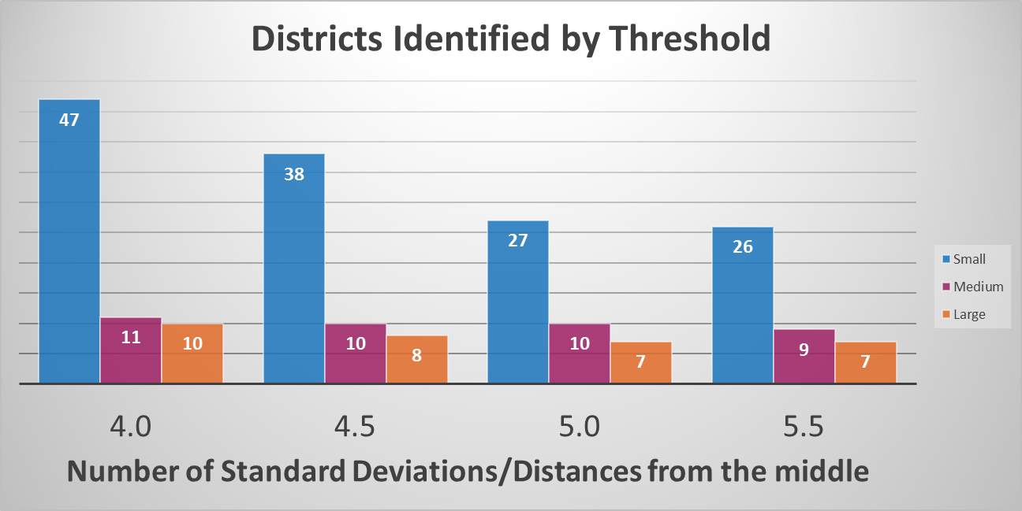
One-Year Variable Threshold Target
Notes:
Below 4.0, the target identifies nearly all districts.

Slide 74
Multi-Year Variable Threshold Target
Notes:
Below 4.0, the target doubles the number of districts identified.

Slide 75
Polling

Slide 76
Poll Everywhere
Notes:
Now I’m going to ask for your opinion using the Poll Everywhere service. You’ll use your phones, tablets, or laptops to respond. So please take out your device, but remember to leave it on silent.

Slide 77
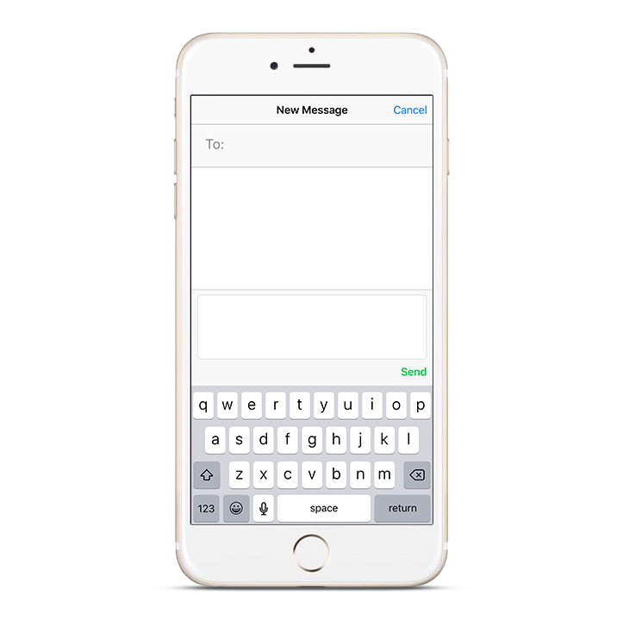
Poll Everywhere How-to 1
Pollev.com/ordepted
ORDEPTED
22333
<your response>
Notes:
You’ll participate by sending a text message

Slide 78
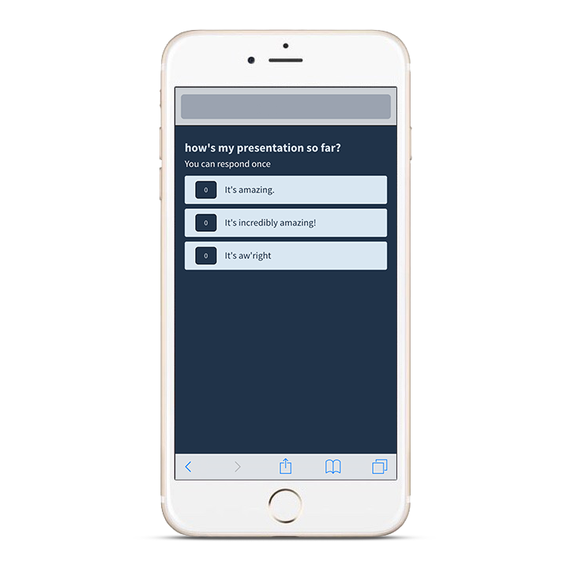
Poll Everywhere How-to 2
Pollev.com/ordepted
ORDEPTED
Pollev.com/ordepted
Notes:
You’ll participate by visiting my voting web page from any browser.

Slide 79
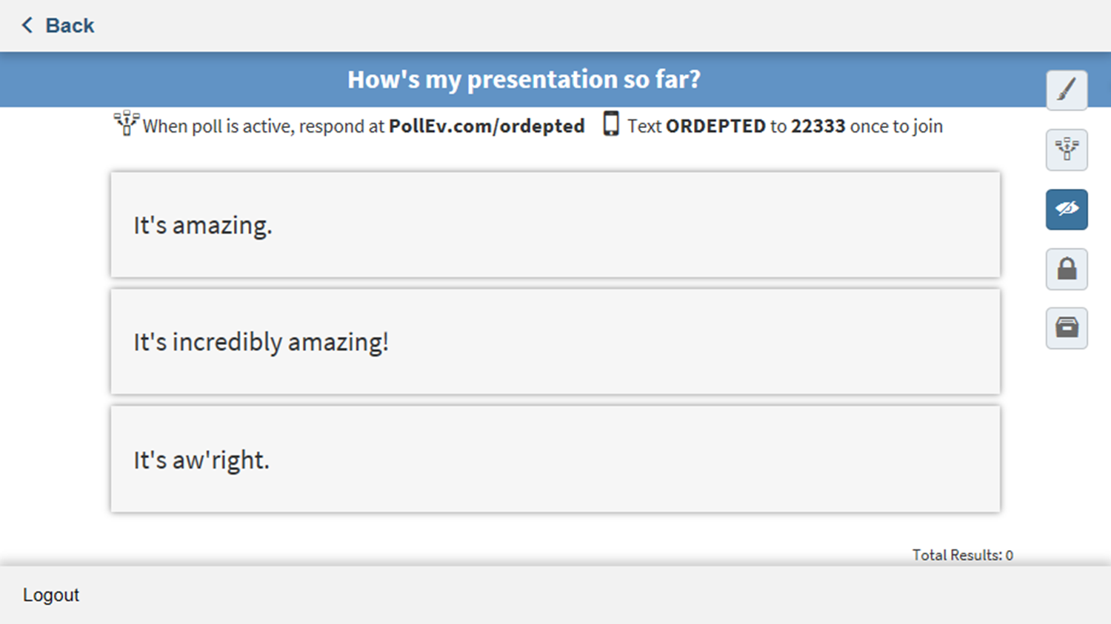
Question 1
Notes:
Let’s do a quick question now to get the hang of it. Everyone take out your device and tell me – How’s my presentation so far?
(If responding by text message), start a new text message. You’ll put the five digit code 22333 in the “to” line. Type in ORDEPTED and press send. Then enter your answer.
(If voting via the web), visit pollev.com/ordepted. Wait for the question to appear, and respond with a click.

Slide 80
Main Survey
pollev.com/ordepted
Notes:
Now we’re going to open up the main survey. If you have already gone to the webpage pollev.com/ordepted, stay there and it will update automatically.

Slide 81
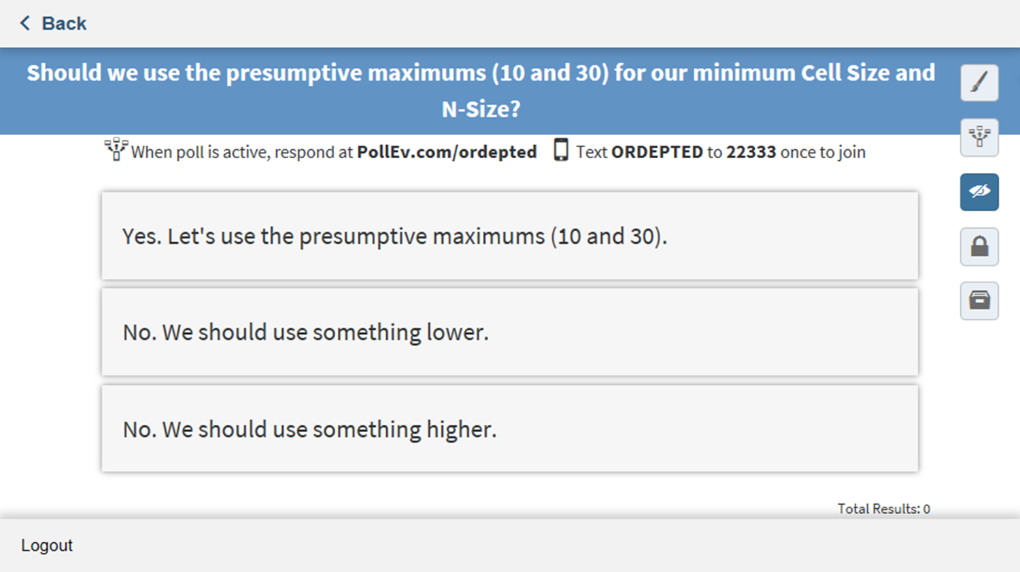
Question 2

Slide 82
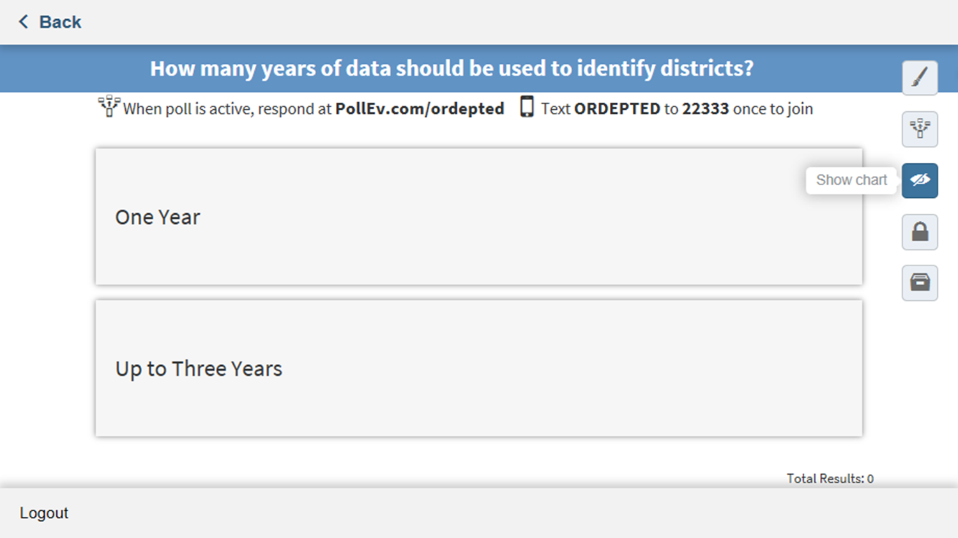
Question 3

Slide 83
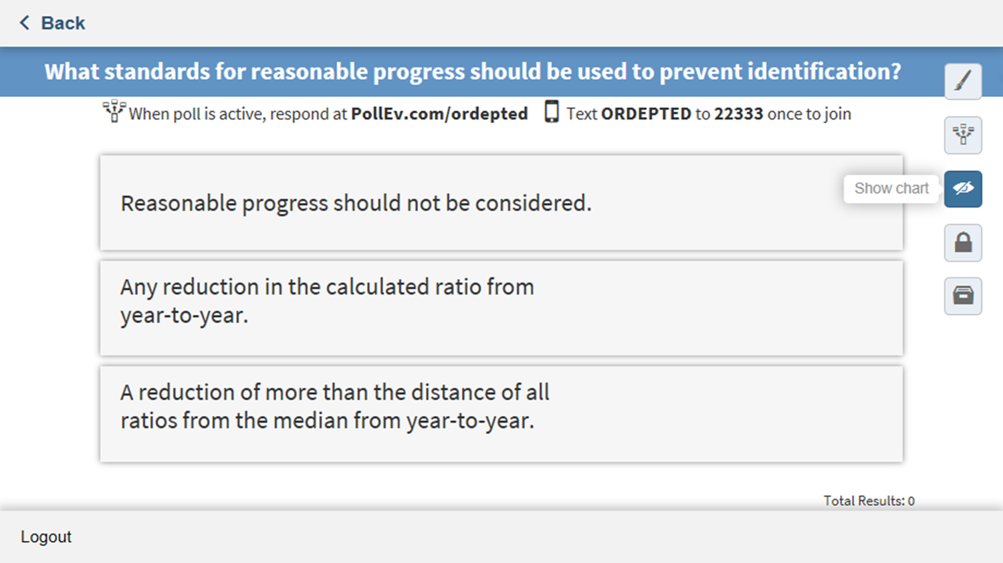
Question 4

Slide 84
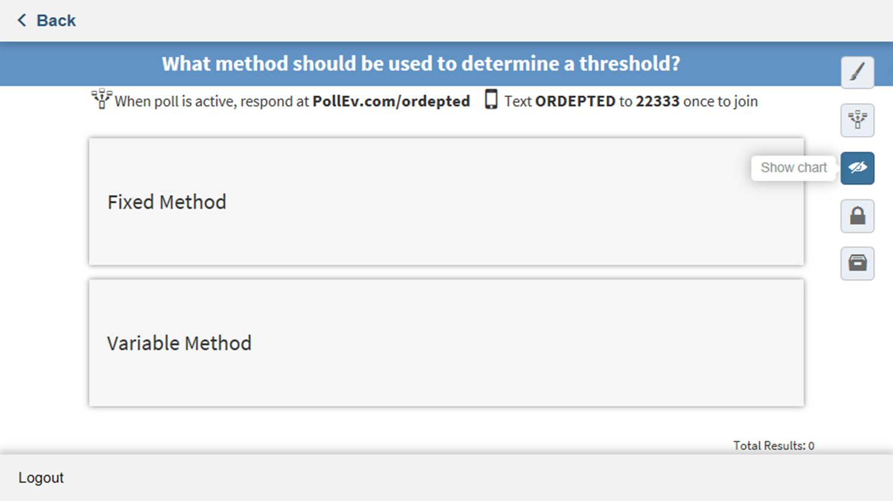
Question 5

Slide 85
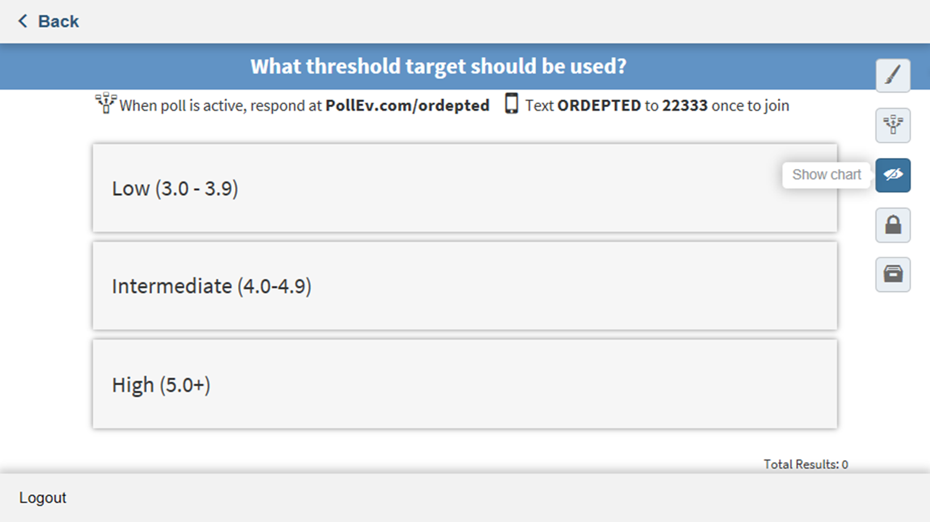
Question 6

Slide 86
Wrapping Up

Slide 87
Questions?
Notes:
Any final questions at this point?

Slide 88
Thank You
Thank You
James Foutch
(503) 947-5776
james.foutch@state.or.us

