Slide 1
Using HIA on Climate Change Policy: a Training Course for Public Health Professionals
Chapter 5 Assessment
Notes:
Point of slide: Space holder while introduce and explain what we had in mind.
Welcome and introductions.
The purpose of this training module is for local, state and federal public health agency professionals to understand how to apply Health Impact Assessment practice to Climate Change Policy.
See the Participant’s Guide for a complete list of all learning objectives and a description of the training elements and structure.
In Chapters One learners will:
Review how climate change will potentially impact health,
Review HIA stages,

Slide 2
Steps of an HIA: Assessment
1.Screening | Determines the need and value of a HIA
2.Scoping | Determines health impacts to evaluate, methods for analysis, and a workplan
3.Assessment | Profiles existing health conditions and evaluates the direction and magnitude of potential health impacts
4.Recommendations | Provide strategies to manage identified adverse health impacts
5.Reporting | Communicates the HIA findings and recommendations
6.Monitoring and Evaluation | Tracks: 1) impacts on decision-making and the decision 2) Impacts on health determinants
Notes:
Point of Slide:
A review of the assessment stage of an HIA.

Slide 3
Assessment: Learning Objectives
Identify strategies for handling complexity and uncertainty.
Identify relevant quantitative methods to measure health effects.
Identify potential data sources to measure climate change related policy health effects.

Slide 4
Assessment: Complexity and Uncertainty
Notes:
Purpose of slide: Indicate challenge.
Refer to the Toolkit for the UCLA Screening/Scoping Checklist

Slide 5
Climate Change Policy HIA CHALLENGES
Multiple, interacting policy elements
High degree of uncertainty in climate change impacts
High degree of uncertainty in the magnitude of health impacts
Charged political environment
Long timeline for many of the health impacts
Notes:
Purpose of slide -

Slide 6
Handling Complexity – Strategy #1: Describe impacts qualitatively
Planting of trees in an urban area will decrease heatstroke and heart disease, especially among the elderly.
vs.
Planting 800 trees in the downtown area will reduce heatstroke by an estimated 25%, saving an average of 10 lives per year.
Notes:
Example
Valuable when resources are limited
Can inform policy recommendations even when there is no magnitude of data available.

Slide 7
Handling Complexity –
Strategy #2: Break down all policies into constituent pathways, to understand interactions
Increase minor collisions
Reduce fatalities
Increase residential density
Decrease major collisions
Improve bicycle infrastructure
Positive or negative change in non-fatal injuries ?
Decrease minor collisions

Slide 8
Handling Complexity – Strategy #3: Build a quantitative model of interacting policies, and use sensitivity analysis
Examples:
Tradeoffs:
Agent-based modeling
Environmental systems modeling
Transportation scenario planning
Agricultural crop modeling
Economic forecast model
Contract with technical specialist
Time to build, test and run model
Uncertainty in the internal validity of model

Slide 9
Approaches for Using Models in HIAs
Don’t use quantitative model, and describe results qualitatively only (most common approach)
Incorporate a quantitative analysis as a small component of an HIA (e.g. a return on investment analysis)
Use outputs from an existing model in the HIA assessment (e.g. transportation planning models or climate impact models)

Slide 10
Model Example #1 – Woodcock et al.
Notes:
Evidence of Short Term Health Effects of Particulate Matter and Ground Level Ozone
To get a sense of the amount of ambient particulate matter Table 5 compares Alachua County’s total to TEC. Alachua County has maximum 24 hour mean PM₁₀ µg/m³ of 61 from all sources (Table 4). TEC’s maximum 24 hour mean increase in PM₁₀ µg/m³ of will be about 0.87 according to ECT. The annual ambient mean for Alachua is 18.7 whereas the estimated increase in ambient particulate matter mean for TEC is 0.133.
Lake Oswego Transit Model
Cap and Trade Economic model - jobs

Slide 11
Model Example # 2- Famine Early Warning System
Designed to predict famines to prepare for humanitarian efforts
Integrates remote sensing data with economic models
Model can be used to predict impacts of climate change on famine and adaptation strategies
Notes:
Explain why a really good model

Slide 12
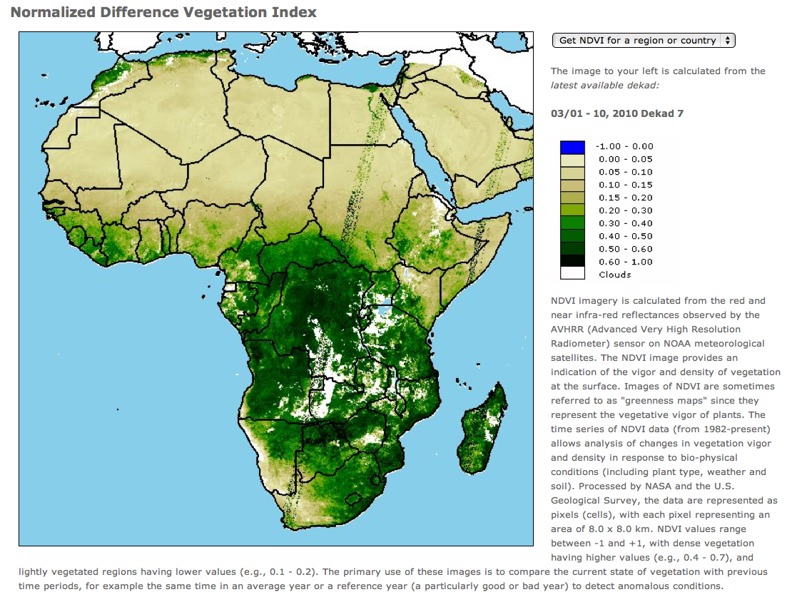

Slide 13
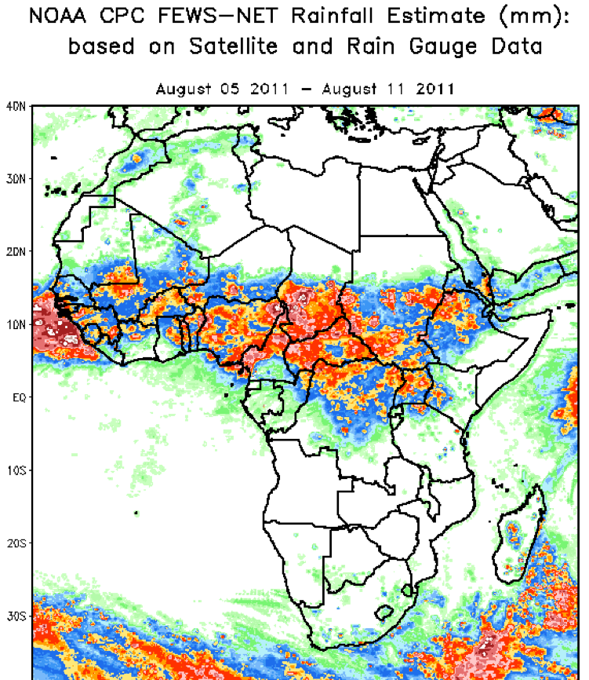

Slide 14
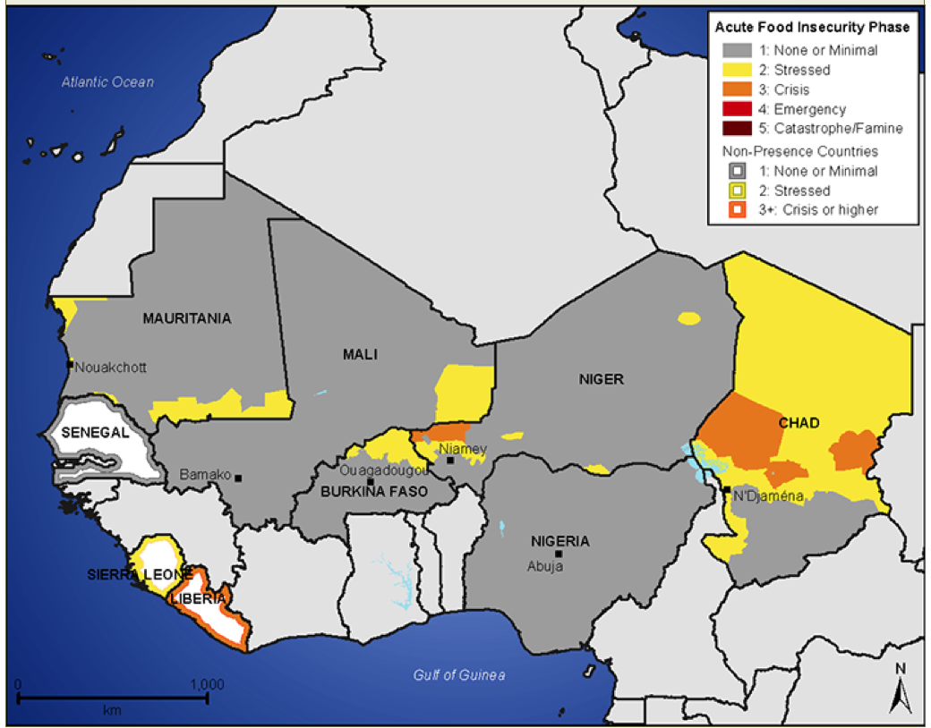

Slide 15
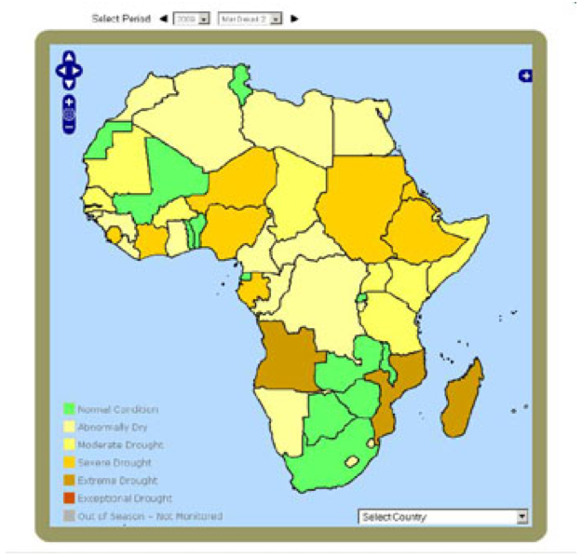

Slide 16
Model Example #3:
The New York Climate and Health Project
Links models for global and regional climate, land use and cover, and air quality…
Purpose was to examine the potential public health impacts of ozone under alternative scenarios of climate change and regional land use in the 2020s, 2050s, and 2080s in the New York City (NYC) metropolitan region.
World Health Organization Climate Change Training Module 2008, Ch 14 Air Quality;
Kinney et al 2006.
Notes:
The overall goal of New York Climate and Health Project is summarized here.

Slide 18
Models and HIAs - Considerations
Look for opportunities to use modeling in HIAs
Very few HIAs currently model climate change impacts
Requires content and technical expertise

Slide 19
Qualitative Tradeoffs
Difficult to communicate qualitative findings to decision makers
Stakeholder engagement takes time and resources
Not seen as rigorous as quantitative analysis

Slide 20
Types of Uncertainty
Details of policy implementation
Future political climate
Economic outlook
Future weather, temperature and sea level

Slide 21
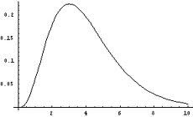
Measuring Uncertainty

Slide 22
Handling Uncertainty
1) Strategy #1: Create scenarios
CO₂ Emission Scenarios
Hansen J et al. PNAS 2000;97:9875-9880
Notes:
Example

Slide 23
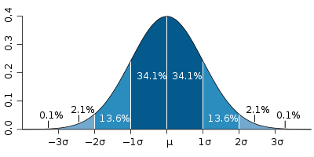
Handling Uncertainty
2) Strategy #2: Use models that incorporate probability
Notes:
Example

Slide 24
Handling Uncertainty
3) Strategy #3: Create HIA recommendations that increase certainty around positive health outcomes
Examples:
Building codes that prepare for more extreme events
Investments in research to understand uncertainty
Notes:
Example

Slide 25
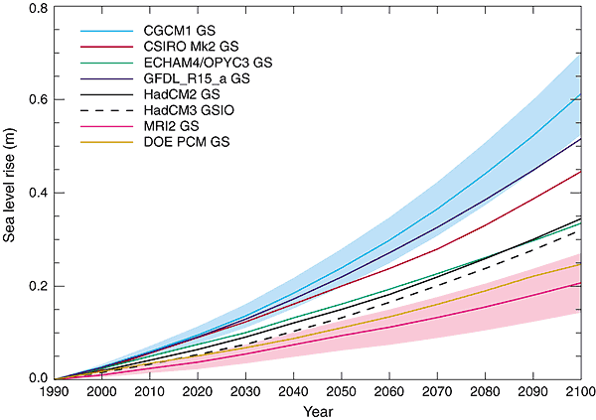
Long Timeline for Health Impacts

Slide 26
Determining the Timeline of Assessment Results
Dependent on timeline of health impacts or planning timeline
Co-benefits often have a shorter timeline of impacts than direct climate change impacts
The longer the timeline, the more uncertainty in assessment results

Slide 27
Data Sources for Climate Change HIAs
CDC, U.S. Census Bureau, population health surveys, National Center for Health Statistics, Agency for Healthcare Quality and Research, Administrative datasets
NASA, National Oceanic and Atmospheric Administration
WebGIS, The USGS Land Cover Institute, Economic Research Service/USDA
Health data and behavior surveys
Remote sensing data
Land use data

Slide 28
Data Sources for Climate Change HIAs
Transportation data
Demographic data
Economic data
USDOT – Research and Innovative Technology Administration Bureau of Transportation Statistics, State DOT’s
U.S. Census Bureau, state agencies, county agencies, non profits, hospitals
US Census, Economic Research Service, Bureau of Labor
Notes:
Do we want to create a table list of this stuff?

Slide 29
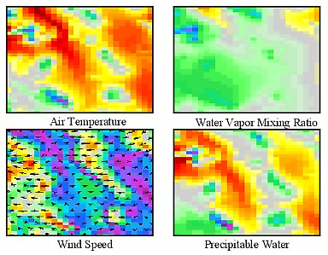
Data Example: Remote Sensing
Notes:
NEXRAD
Satellite imagery
Remote estiations of evaporation

Slide 30
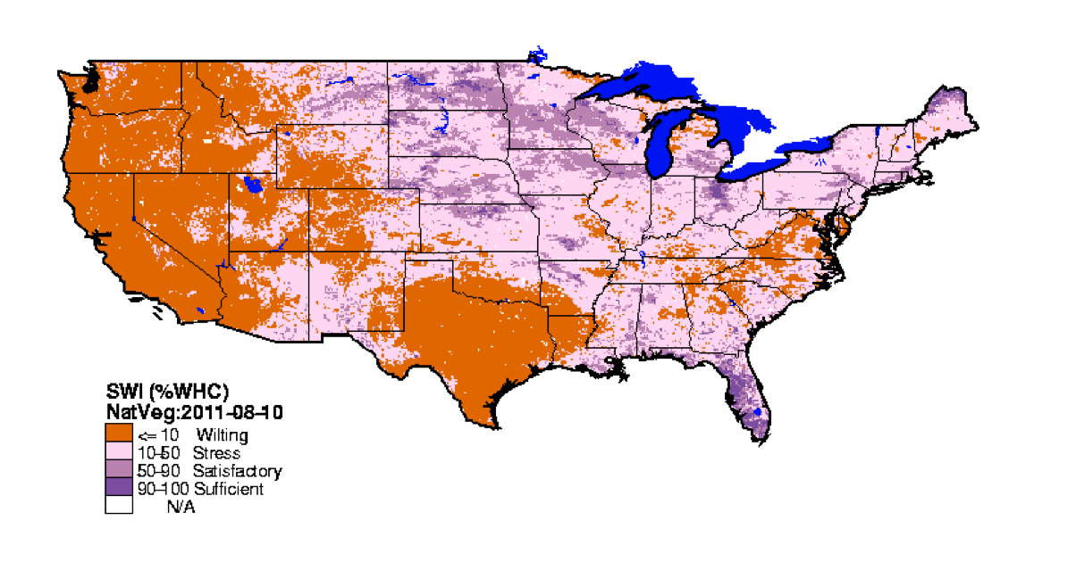
Data Example: Soil Water Index

Slide 31
Data Example: Health, Epidemiology Case Study 2 Taylor Energy Center
Notes:
Point of slide: Example of epidemiologic data used in the Taylor Energy Center project.
1. The HIA practitioners looked at existing age and race adjusted death rates. They found that Taylor County residents have higher age-adjusted death rates for the top causes of death than the state average (higher average death rates fro heart disease, cancer, stroke, chronic lower respiratory disease (CLRD), and diabetes than the state average). Black residents had higher rates than white residents. Taylor County residents were more likely to be obese, smoke and exercise less than others in the state. Nearly 1/3 of population was uninsured.
DYNAMO is a model using epi evidence
Others…
Epi is no different – but the impact of climate change policy may be more difficult to find,
So
Taylor County Florida HIA Example -
The analysis found that particulate matter (PM₁₀) and ozone pollution from the plant would lead to small increases in mortality and other impacts, such as global warming, due to carbon dioxide emissions. They also found that new jobs created from the coal plant could have either a null or a positive effect on health, depending on the demographic profile of those employed by the newly created jobs.
Because of existing income disparities in the region, significant positive health impacts, such as reduced mortality, were predicted if Black residents were employed in the midlevel positions. The HIA recommended that the coal plant hire a representative demographic distribution of Whites and Blacks. The Economic Development Authority accepted this recommendation and said they would work with the training institutions to recruit Black workers, although the Economic Development Authority had no authority to enforce the recommendation on the company (M. Simmons, PhD, written communication, 2007)*. This positive attitude was felt by the community, although the company stopped the coal plant's construction because of the plant's risk for climate change.
____________

Slide 32
Data Example: Census Tract Data from Baltimore Zoning Code HIA
Notes:
______________________
Image Source: Thornton RLJ, Fichtenberg CM, Greiner A, Feingold B, Ellen JM, Jennings JM, Shea MA, Schilling J, Taylor RB, Bishai D, Black M. Zoning for a Healthy Baltimore: A Health Impact Assessment of the TransForm Baltimore Comprehensive Zoning Code Rewrite. Baltimore, MD: Johns Hopkins University Center for Child and Community Health Research.

Slide 33
Identifying Inequitable Impacts Example
Image Source:
Notes:
Point of Slide – Discuss the fact that while the HIAs covered potential inequities, identified co-benefits and co-costs, decision makers may have chosen to ignore it. (This is a moral to the story of why it is so imperative that we as health professionals at the very least make the case for
Two HIAs conducted on AB 32; both included suggestions to address inequities that would result from the policy.
If policy makers worked to address these concerns, environmental justice activists did not think it was sufficient.
Environmental justice groups sued the state of California on grounds that they violated the state’s Environmental Impact Assessment law (look this up and get specific).

Slide 34
Exercise 5 in the Toolkit
Identify research questions
Identify methods
Quantitative
Qualitative
Identify data sources

Slide 35
Useful Assessment Tools
Healthy Development Measurement Tool
UCLA Decision Analysis Tool
Considers health needs in new developments
Describes key indicators for a healthy built environment
Helps decision makers weigh policy elements and policy impacts
Includes considerations of equity, magnitude of impact, timeline and political feasibility
Designed to be a useful tool for decision makers
See Toolkit for Decision Analysis Description

Slide 36
Participatory Process: Potential Challenges
Controversy over climate change
Many scientific disciplines may be involved
Abstract or uncertain outcomes of assessment

Slide 37
Participatory Process: Potential Approaches
Create a technical advisory committee that is separate from a community or stakeholder advisory committee
Communicate what the HIA will assess and what it will not
Stakeholder input in scoping and recommendations stages most critical
Plan for significant time to bring everyone up to speed on HIA practice and scientific disciplines involved

Slide 38
Assessment: VMT HIA Example
Qualitative
Literature review
Quantitative
Air pollution data
Collisions data
Physical activity data

Slide 39
Assessment: Taylor County Coal Plant
Qualitative
Interviews
Multi-media content analysis
Quantitative
U.S. census data
Housing indicators
Economic indicators
Notes:
Housing
Economy

