Slide 1
Grand Ronde Health and Wellness Center: Immunization Rate
Amanda Walker, CMA, Immunization Program Coordinator
Jennifer Lott, CMA

Slide 2
Historical Immunization Program at Grand Ronde Health and Wellness
Difficult to manage immunizations due to having to be charted in 3 different systems
NextGen
RPMS
Oregon Alert
Immunizations were not standardized amongst practitioners
Although there were standing orders not all providers would give all immunizations per schedule
Some providers would stop support staff from giving immunizations during walk-in visits because children were not up to date on well child check
Lack of trust in safety of vaccines by community

Slide 3
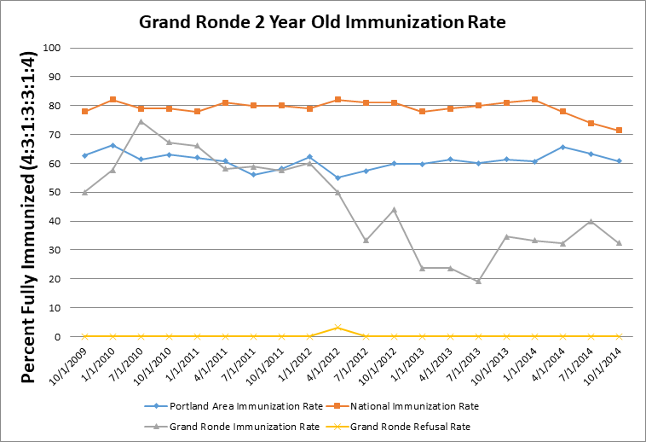
Long Standing History of Low Immunization Rates

Slide 4
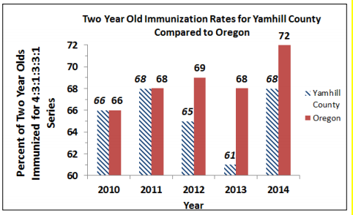
Long Standing History of Low Immunization Rates: Yamhill County

Slide 5
AFIX Program and Grand Ronde Health and Wellness Clinic
AFIX (Assessment, Feedback, Incentives and eXchange) is a continuous quality improvement process informed by research and used for improving immunization rates and practices at the immunization provider level
The AFIX components once understood and implemented by providers, can assist practices in meeting immunization coverage goals for a variety of standards, including but not limited to Healthy People 2020 and HEDIS (Healthcare Effectiveness Data and Information Set) measures
Grand Ronde Health and Wellness Center started AFIX on March 8, 2018

Slide 6
Steps to increase immunization rates: RECALLS
Letters were sent through Oregon Alert to active patients behind on immunizations
Utilized NextGen to set up recall letters for patients due for a Well Child Check with their primary care provider

Slide 7
Steps to increase immunization rates: Pediatrician Team
Welcomed Dr. Alison Empey to our team in August 2018
Dr. Empey provides care to our pediatric population on the 2nd and 4th Mondays and Tuesdays every month
Jennifer, CMA and Charlene, LPN are dedicated to our pediatric population
Reaches out to patients the business day before their appointment to remind them of their appointment
Reaches out to patients that no-shows to coordinate care with Dr. Empey or another provider or set up a visit for immunizations only
Developed reporting tools to capture children not connected to care
Dr. Empey has joined the health advisory committee for our Head Start Program
Coordinated effort between medical clinic and Head Start Program to ensure children are immunized appropriately.
Head Start will provide transportation to Medical Clinic if needed by parents to get immunizations
Dr. Empey provides information to other providers and support staff on best practice surround childhood care and immunizations

Slide 8
Steps to increase immunization rates: Education
Social Media Page
Information is placed on the social media page about immunizations at key times such as school exclusion and the beginning of the school year to encourage families to bring in children for their immunizations
Sport’s Physical Event
Incentives offered to students needing sport’s physicals to come in for an event where all providers are seeing kids.
Immunizations are given at Sport’s Physicals
Smoke Signal
Educational Articles have been submitted to our tribal newspaper to increase education among the community.
Community Events
Immunization information is available at community events to provide education to community members.

Slide 9
Immunization Rates As of 10/1/19
Missed Opportunities^{[5]}: 17% (decrease of 10% from 27%)
^{[1]} Active patients in ALERT IIS that were 24-35 months old as of the assessment date.
^{[2]} Vaccination status is as of this date. Immunizations administered after this date are not included in this assessment.
^{[3]} 4+ DTaP, 3+ Polio, 1+ MMR, 3+ Hib, 3+ HepB, 1+ Varicella, 1+ PCV
^{[4]} County rates are based on all residents according to their most recent address in ALERT IIS
^{[5]} Not all recommended vaccines were administered at a patient’s most recent immunization visit

Slide 10
Immunization Rates As of 10/1/19

Slide 11
Questions?

