Slide 1
Immunizations in Oregon
Rex Larsen, Quality Improvement Program Manager
Oregon Immunization Program

Slide 2
What we’ll talk about today:
Childhood immunization in Oregon
HPV vaccination in Oregon
ITU Clinic rates
Risks and opportunities

Slide 3
Recent improvements in childhood immunization rates

Slide 4
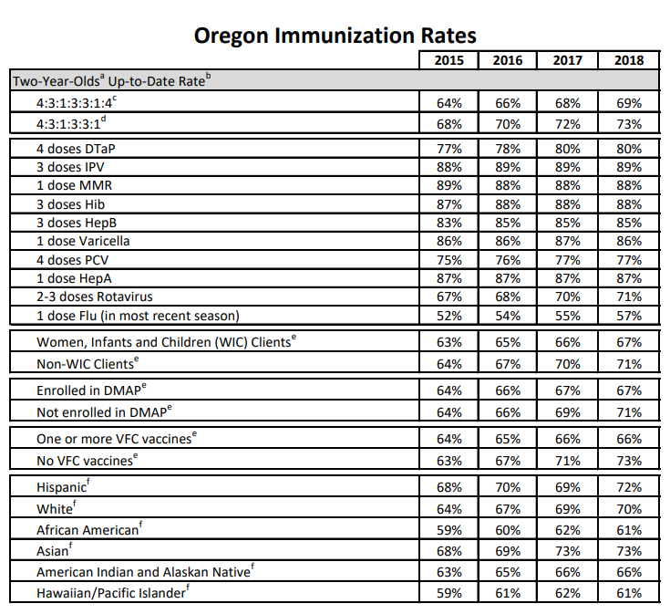
https://www.oregon.gov/oha/PH/PREVENTIONWELLNESS/VACCINESIMMUNIZATION/Pages/researchchild.aspx

Slide 8
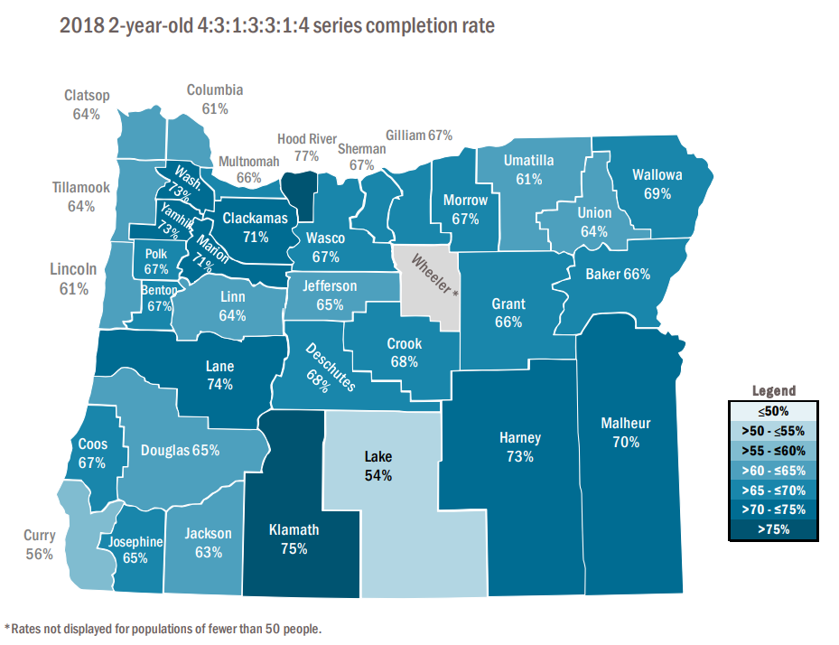

Slide 9
ITU Clinic rates for 2-year-olds
State average 69%

Slide 10
What’s the potential impact of these disparities?

Slide 11
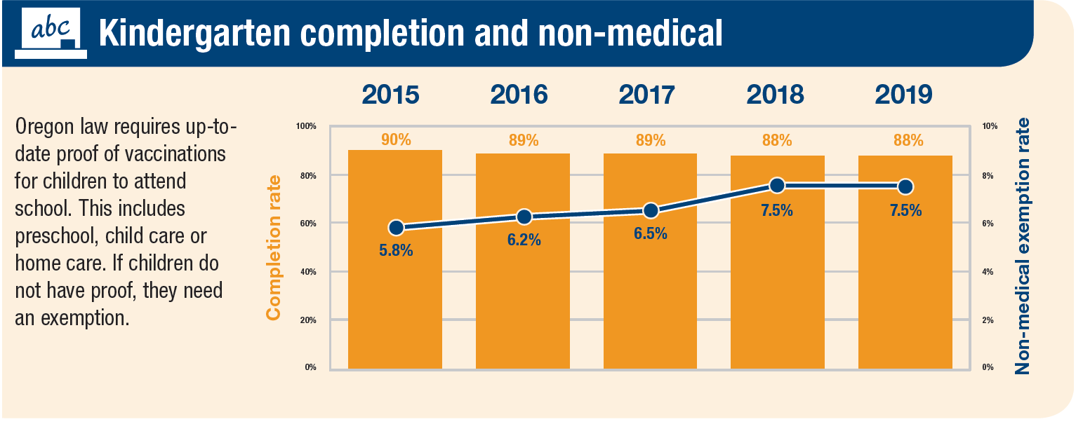
Highest number of measles cases since 1991
Increasing school exemptions and stagnating immunization rates in close knit communities
Erosion of vaccine confidence in some communities
https://www.oregon.gov/oha/PH/PREVENTIONWELLNESS/VACCINESIMMUNIZATION/Pages/researchschool.aspx

Slide 12
Oregon has had an average of <3 measles cases per year since 1993
n = 88
*data as of 10 August 2019
Notes:
More measles cases this year than any year since 1991.
We don’t yet have any sustained community outbreaks.
The vast majority of disease cases (88% nationwide in 2019) are associated with close knit communities

Slide 13
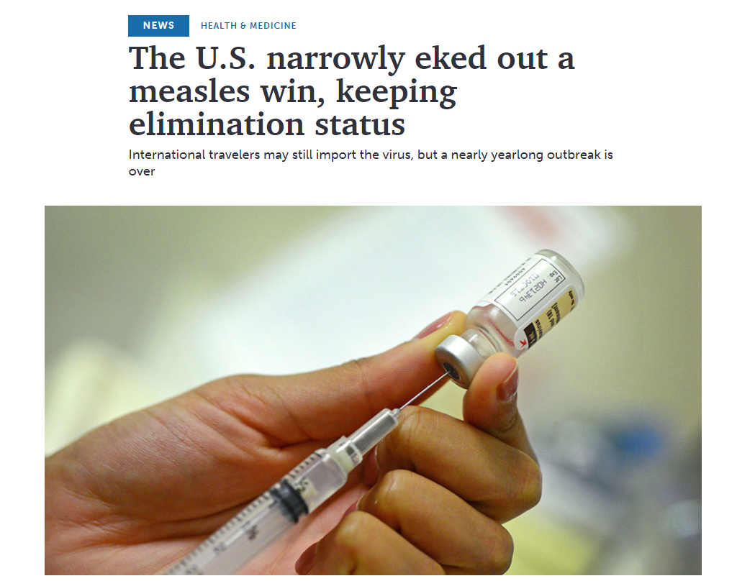
https://www.sciencenews.org/article/united-states-measles-outbreak-elimination-status

Slide 14
Childhood Immunizations summary
Childhood immunization rates have been increasing incrementally
Vaccination rates for some minority groups and close knit communities are increasing more slowly than average
DTaP and PCV are the most difficult vaccines to get in by the 2nd birthday but close knit communities may have specific vaccines of interest
This spring’s measles outbreak highlighted the continued importance of working on 2-year-old vaccination

Slide 15
Adolescent Immunizations in Oregon
Notes:
So how does what happened in the Ukraine relate to Oregon.
It’s an extreme example obviously

Slide 16
HPV cancers in Oregon, 2015-2016
Notes:
Oregon State Cancer Registry 2015-2016 data.
Site and histology code
Cervix: Site (C53.0-53.9), histology (8010-8671, 8940-8941)
Vagina: Site (C52.9), histology (8050-8084, 8120-8131 ) Vulva: Site ( C51.0-C51.9), histology (8050-8084, 8120-8131 )
Ano-rectal: Site (C21.0-21.8, C20.9, histology (8050-8084, 8120-8131 )
Penis: site (C60.0-C60.9), histology (8050-8084, 8120-8131 )
Oropharynx: (C01.9, C05.1-2, C02.4, C02.8, C09.0-09.1, C09.8-09.9, C10.1-4, C10.8, C10.9, C14.0, C14.2, C14.8), histology (8050-8084, 8120-8131)

Slide 17
Cervical and oropharyngeal cancer trends in Oregon, 2000-2016
Notes:
And unfortunately the incidence rate for Oropharyngeal cancer is increasing.
In 2016 it overtook cervical cancer in the US as the most common HPV related cancer.
Incidence rate for cervical cancer in Oregon- Trend in 2000-2016
Incidence rate for oropharyngeal cancer in Oregon- trend in 2000-2016 (both men and women)
*Rates are per 100,000 and age-adjusted to the 2000 US Std Population (single ages to 84 - Census P25-1130) standard.

Slide 18
Notes:
If this continues, in ten years rates will be high enough that we may be able to eliminate HPV related cancers

Slide 19
HP 2020
Goal = 80%

Slide 20
Urban and rural disparities

Slide 21
Provider Champions

Slide 22
2019 Oregon HPV Rates by Race/Ethnicity, Ages 13-17
HPV Completion
2018 2019
White 43.1% 48.7%
Black 47.1% 52.6%
American Indian/Alaskan Native 51.3% 59.8%
Asian 48.0% 54.9%
Native Hawaiian/Pacific Islander 45.5% 52.5%
Latino 48.0% 55.1%
note: categories are not mutually exclusive

Slide 23
Starting vs Completing
The problem of HPV completion is a problem of timely HPV initiation
Teens who start on time are 1.4 times as likely to complete the HPV series as teens who start late

Slide 24
2018 HPV Completion Rates by Age of Initiation, Girls ages 13-17

Slide 25
What can we see in the data that may indicate why teens aren’t getting vaccinated?
Putting off immunizations
Getting only school-required immunizations (Tdap)
Prioritizing other immunizations such as Meningococcal over HPV
76% of teens who didn’t finish had the opportunity to complete the series, but received only school required vaccinations or prioritized Meningococcal over HPV

Slide 26
ITU Clinic rates for 13-year-olds
State average 33%

Slide 27
ITU Clinic rates for 13-17-year-olds
State average 51%

Slide 28
What impact can we have by improving our HPV vaccination rate?

Slide 29
HPV Vaccine in Australia
Elimination of cervical cancer by 2035 possible
Vaccine delivered through school vaccination program
77% reduction in high risk HPV types
50% reduction in Cervical abnormalities in young adults
90% reduction in genital warts in young adults
http://www.hpvvaccine.org.au/the-hpv-vaccine/has-the-program-been-successful.aspx
Notes:
Where they are on track to eliminate cervical cancer by 2035 or so.
They’ve had incredible reductions in HPV related disease.
Cervical abnormalities in young women have been halved.
90 percent reduction in genital warts.

Slide 30
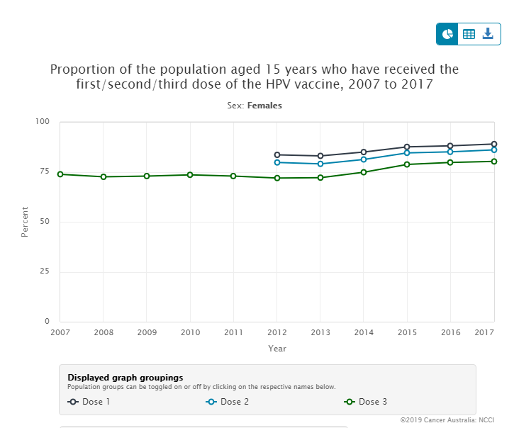
HPV Vaccination Rates in Australia
Australia's vaccination rates for HPV
https://ncci.canceraustralia.gov.au/prevention/hpv-vaccination-uptake/hpv-vaccination-uptake
Notes:
They had early success focusing on cancer prevention with HPV vaccination
Unlike the united states where HPV vaccine became focused on STI prevention.
They’ve had a decade long stretch with vaccination rates in Girls at more than 75%

Slide 31
Oregon HPV Immunization Summary
Rates of HPV initiation and completion are slowly increasing in Oregon.
Increases are happening across all categories of race/ethnicity
The completion gap between girls and boys is narrowing
Starting HPV on-time and completing HPV series are closely linked
Rural-Urban and northern-southern region disparities exist in Oregon for HPV
HPV vaccination represents one of our greatest opportunities to reduce morbidity caused by vaccine preventable disease

Slide 32
Any Questions?

