Slide 1
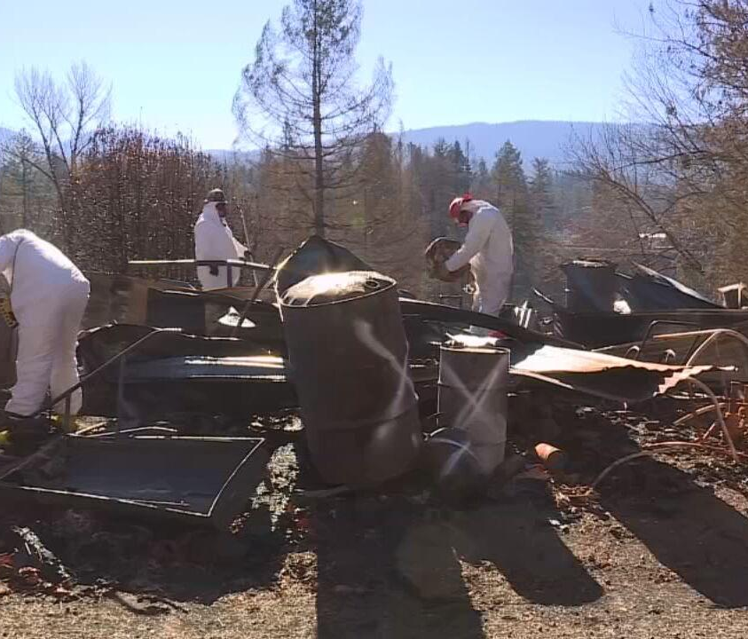
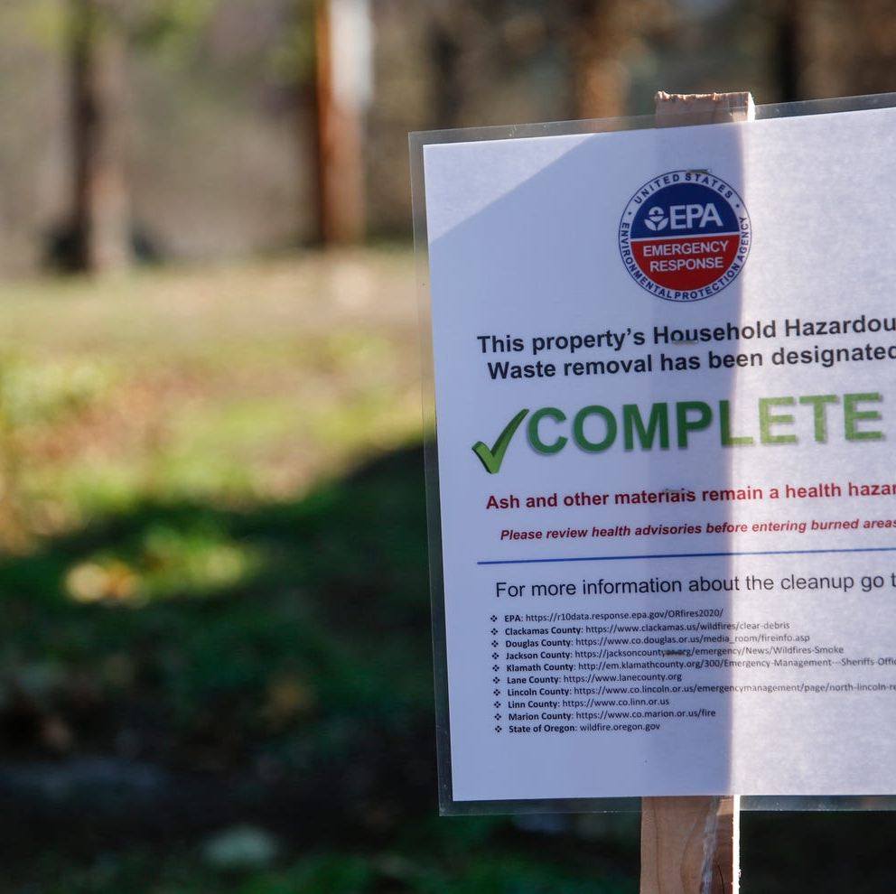
Integrated Strategic Recovery Team Overview
Stan Thomas State Disaster Recovery Coordinator
Oregon Office of Emergency Management
Joan Rave Senior Strategic Advisor
FEMA-DR-4562-Oregon

Slide 2
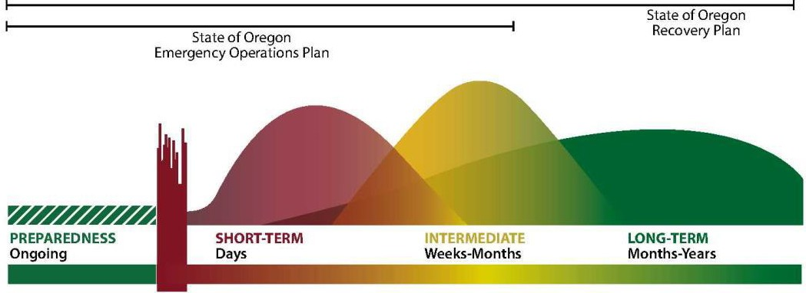
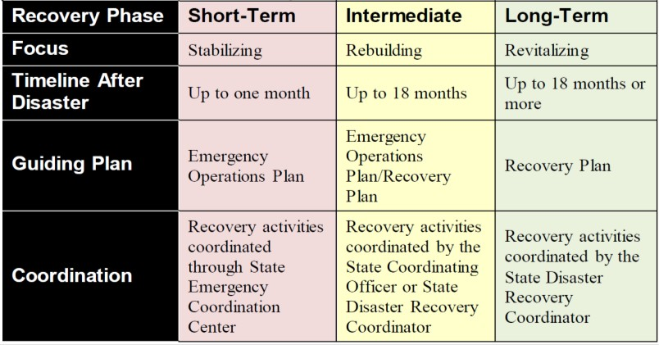
State of Oregon Emergency Operations Plan

Slide 3
Oregon Recovery Plan - Supporting Agencies
INTERAGENCY RECOVERY COORDINATION STRUCTURE
State Recovery Function | State Coordinating Agency | Federal Coordinating Agency
SRF 1 - Community Planning and Capacity Building | Oregon Dept. of Land Conservation and Development | USDHS – FEMA US Environmental Protection Agency
SRF 2 – Economic Recovery | Business Oregon | US DOC – Economic Development Administration
SRF 3 – Health | Oregon Health Authority | US Dept. of Health and Human Services
SRF 4 - Social Services | Oregon Dept. of Human Services | US Dept. of Health and Human Services
SRF 5 - Housing | Oregon Housing and Community Services | US Dept. of Housing and Urban Development
SRF 6 - Infrastructure | Oregon Dept. of Administrative Services Oregon Dept. of Energy Oregon Dept. of Transportation Public Utility Commission of Oregon OEM Public Assistance | FEMA Public Assistance
SRF 7 - Natural and Cultural Resources | Oregon Dept. of Land Conservation and Development | US Dept. of the Interior
Advisory |  | US Environmental Protection Agency US Dept. of Agriculture – Rural Development FEMA Philanthropic Advisor

Slide 4
Integrated Strategic Recovery Team
Strategy
Unify & Coordinate Federal & State Agencies (Oregon OEM & FEMA)
Provide architecture for coordinating federal, state and partner resources
Unify agencies to
Combine resources & funding for projects
Reduce duplication of effort
Reduce burden on jurisdictions
Locally Executed
State Managed
Goals
Identify & Resource Funding and Assistance Gaps
Target Technical Assistance for Recovery Planning
Leverage State, Federal, and Donor resources to fund community rebuild planning & projects
Federally Supported

Slide 5
Timeline for County Outreach
2/5 – 2/18/2021 Initial Recovery Coordination Overview
Lincoln, Jackson, Marion/Linn, Lane
3/4 – continuing SRF 1 - Community Planning & Capacity Building
Organize for Recovery Planning
Identify Recovery Priorities
Funding and Capacity Opportunities

