Slide 1
OregonServes
Fiscal Grants Management
Madeline Seghers & Alma Plasencia
AmeriCorps Oregon Program Officers

Slide 2
Grants Management Components
Regulations & Requirements (Terms &Conditions/ OMB Super Circular)
Financial Management Principles
Policies & Procedures
Internal Controls
Administrative Costs
Documenting Expenses
Match
Reporting & Budgeting (Amendments)
Site Visits
Grant Closeout

Slide 3
Administrative Accounting System Requirements
Distinguish grant verses non-grant related expenses
Identify cost by program year & budget category
Differentiate between direct and indirect costs
Account for each award/grant separately
Record in-kind contribution as both revenue & expense
Provide management with financial reports at both the summary or detailed levels that will compare outlay with budget amounts
Correlate financial reports submitted to CNCS directly to accounting information and supporting documents

Slide 4
Documentation Basics
Why Retain Documentation?
It is required by federal regulations and your contract with the state.
Supports a value, cost, or performance criteria relative to the grant
To track incoming information
To validate information provided by staff, members and/or donors
To provide evidence of accomplishments
To assist during the monitoring activities, audits, or site visits
No documentation may mean no “credit” during a review.

Slide 5
Documentation Basics
Keep Your Documents Organized (systematically)
By grant
By program year
By type of document
Physical information:
Hard copy
Soft copy: CD, flash drive, server, microfilm
Source:
Internal to the organization
External sources
Should reflect appropriate review, approval, sign-off
Examples: Invoices, receipts, timesheets, contracts, in-kind contribution forms, checks deposited, travel claims

Slide 6
Fiscal Systems
AmeriCorps Grant Provisions
“Financial management systems must be capable of distinguishing expenditures attributable to this grant from expenditures not attributable to this grant. The systems must be able to identify costs by programmatic year and by budget category and to differentiate between direct and indirect costs or administrative costs.”
➔ Record in-kind contribution as both revenues and expenses

Slide 7
Acceptable Match is…………..
Cash and in-kind contributions are accepted as part of the grantee’s cost sharing or matching when contributions meet all of the following criteria:
Are verifiable from the grantee’s records and properly documented
Are necessary and reasonable for proper and efficient accomplishment of project or program objectives
Are allowable under the applicable OMB cost principles
Are not paid by the Federal Government under another award, except where authorized by the Federal statute to be used for cost sharing or matching
Are provided for in the approved budget (allowable under program guidelines)
Conform to other grant provisions or OMB Circulars

Slide 8
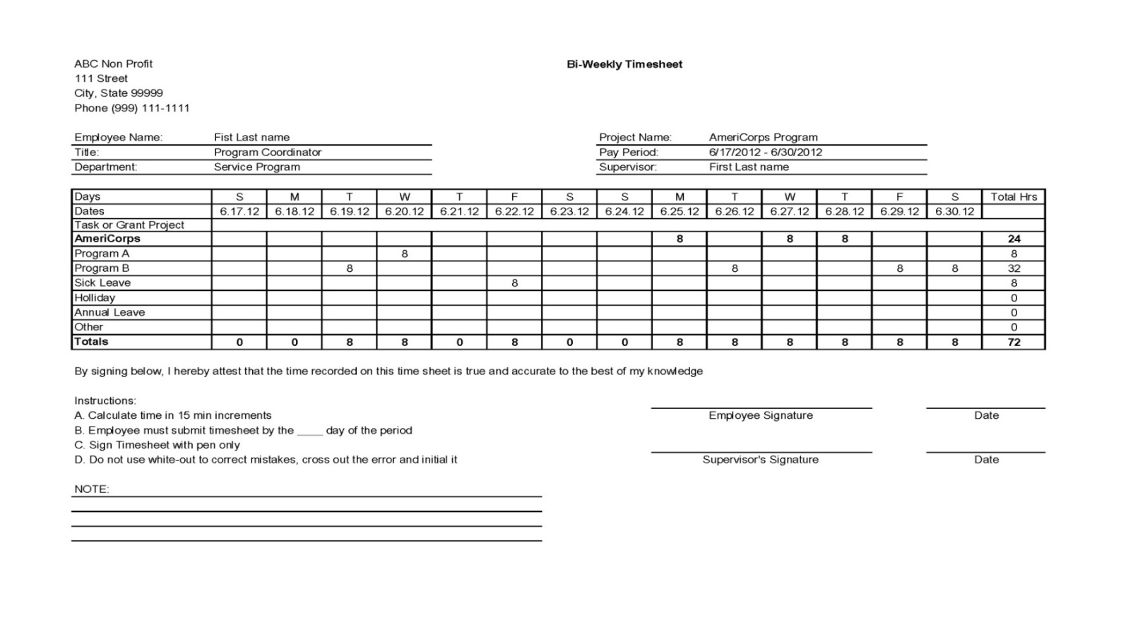
Functional Timesheet Sample

Slide 9
Personnel Electronic Timekeeping System Requirements
CNCS policy allows AmeriCorps State and National grantees to use electronic timekeeping systems as the system of record when three conditions are met:
A written policy is in effect establishing the use of electronic timekeeping system as your system of record; and,
A secure, verifiable electronic signature system (a) identifies and authenticates a particular person as the source of the electronic signature; and (b) indicates such person’s approval of the information contained in the electronic message.
Once appropriate electronic signatures have been applied, no changes may be made unless there is a clear, auditable record of the revision.

Slide 10
Living Allowance Distribution
Notes:
(FAQ Handout)
See CV’s Grantee Central Managing Your AmeriCorps Program page, Fiscal Management folders for this and other resources referenced in this presentation

Slide 11
Invoices
Reimbursement is made based on actual expenses
Reimbursements may not be for estimated, unauthorized, or unallowable expenses
Invoices must be for approved and budgeted expenditures that programs have already incurred
No advances allowed

Slide 12
Invoices
Must also have up-to-date and current:
Member hours
Expense Workbooks
Federal Financial Reports
Program Reports (performance-based)
Must also demonstrate compliance with program operations, i.e., no outstanding corrective action

Slide 13
Invoice Due Dates
Invoices are due by the 21st of the month following the invoice period
Effective immediately, all invoices are to be submitted electronically via OnCorps reporting system
Invoices are submitted monthly

Slide 14
Invoice Review
Only complete and approved invoices are submitted for payment – we send them back if there are errors
You can expect payment about 20 days after the day we receive an error-free invoice
Proofread before submitting—small errors will delay payment
Common errors:
Selecting incorrect program year for the Budget Period
Don’t have enough match reported
Line Item Over Expended/Over Reporting of CNCS or Grantee Share
(Red Numbers in your Workbook = Something is Wrong)

Slide 15
Budget Amendment Guidelines
Budget changes of more than 10% of your total budget or to line items previously allocated $0 must not be implemented before OregonServes approves the change (i.e. don’t purchase/pay for items that are not in an approved budget at the time of purchase).
Adequate written justification must be provided with request—changes need to be consistent with program design and activities.
Budget Modification Request Form must be completed in OnCorps.
Do not submit a major budget change at year-end. This indicates inadequate monitoring of budget throughout the year. There is no guarantee that a year-end change will be approved and you may not be reimbursed for these expenses.

Slide 16
Budget Amendment Guidelines
OSC must receive written approval from CNCS for these budgetary changes:
Specific costs requiring approval under the cost principles, such as:
Overtime pay, rearrangement and alternation costs, and pre-award costs
Purchases of equipment over $5,000 using CNCS funds, unless specified in the approved application and budget
Changes in the cumulative budget line items that amount to 10% or more of the total budget, unless the CNCS share is $100,000 or less
The total budget includes both the CNCS and grantee shares
Grantees may transfer funds among approved direct costs categories when the cumulative amount of such transfers do not exceed 10% of the total budget

Slide 17
How to Submit a Budget Amendment Request
Submit a Budget Amendment Request Form
Narrative justification – explain why a redistribution of funds is needed and how your program is affected.
Excel spreadsheet with the original budget, proposed budget, and difference between two budgets
Must be signed by the Program Director and Legal Applicant and mailed to California Volunteers
Send the request to Deputy Director of AmeriCorps
will either approve or deny – wait to take action only after receiving approval

Slide 18
Budget Amendment Pointers
Your budget = plan of expected costs
Plan may change as the program is implemented
Review budget monthly
Request budget amendments promptly
Do not wait until last month of year to request budget modification
Budget is driven by program needs

Slide 19
Federal Financial Reports
Prepare all financial reports with information from the organization’s accounting system
Review and reconcile the information to ensure accuracy prior to report submission
Submit all reports on time
Proofread before submitting
Submit by April 15th and October 15th
Must be submitted via OnCorps
Required financial information includes:
Program Income
Submission of all invoices for reporting period
Reporting other federal grant sources

Slide 20
Late Reports?
Prior to the due date
By e-mail, request an extension
Provide reason why an extension is needed
State expected date of completion
Expense Reports and FFRs
Submit extension request to oregon.serves@hecc.oregon.gov
HECC Finance reconciles FFRs to Expense Reports.
If they do not tie, expect a call or e-mail!
FFR Due Dates for the Program Year
Period Claiming | Date FFR Due
July-March | April 15th
April-September | October 15th

Slide 21
Compliance Reviews
Corporation for National & Community Service (CNCS) - Improper Payments Elimination and Recovery Improvement Act (IPERIA)
OregonServes (OSC)- Fiscal Desk Review
Office of Inspector General (OIG) - Audit

Slide 22
Common Accountability Problems
System of internal controls should exist on timekeeping under Uniform Grant Guidance
Timesheets cannot be based on budgeted amounts – actual work only
Suggestion 1 – periodically, conduct your own timesheet review audit
Suggestion 2 – provide mandatory training on how to accurately and timely maintain timesheets
Organizations do not:
Separate accounting records for each Federal grant
Submit Federal Financial Reports (FFRs) on schedule
Make sure that the FFRs reconcile to internal accounting records (general ledger)
Record match dollars in general leger, with same detail/documentation as for grants expenditures
Contemporaneously and adequately document source of match contributions
Substantiate market value of in-kind match contributions

Slide 23
Questions?
Madeline Seghers, Program Officer: madeline.seghers@hecc.oregon.gov
HECC Finance: hecc.finance@hecc.oregon.gov

